Slide 1




Behavioral Genetic Data Analysis Bivariate ACE models
August 17th and 18th, 2022
Lecturers: Dr. Bastian Mönkediek¹, Mirko Ruks¹, Christoph Klatzka², Theresa Rohm³ ¹ Bielefeld University, Bielefeld, Germany ² Saarland University, Saarbruecken, Germany ³ Bremen University, Bremen, Germany

Slide 2
Content
Introduction to the bivariate twin model
Trait Covariation and Trait Correlation
Variants of the bivariate model
Factors explaining the heritability of a trait
Explaining the heritability of a trait: The case of gene-environment correlations (rGE)
Outlook
Applied data analysis in R

Slide 3
Introduction to the bivariate twin model
Why do we need bi-/multivariate ACE models?
We can decompose the variance (as in univariat ACE model) of each trait and we can also decompose the covariance of several traits (Plomin et al., 2013)
We can investigate causes of covariation between two traits (e.g., by estimates of bivariate heritability) and delineate genetic and environmental influences on human trait covariation
Besides causes of trait covariances, genetic and environmental trait correlations can be obtained that are additionally informative to answer research questions (de Vries et al., 2021)
Notes:
Distinct information about covariance and overlap between phenotypes are obtained from phenotypic correlations, estimates of bivariate heritability, and genetic and environmental correlations resulting from bivariate twin models (de Vries et al. 2021)

Slide 4
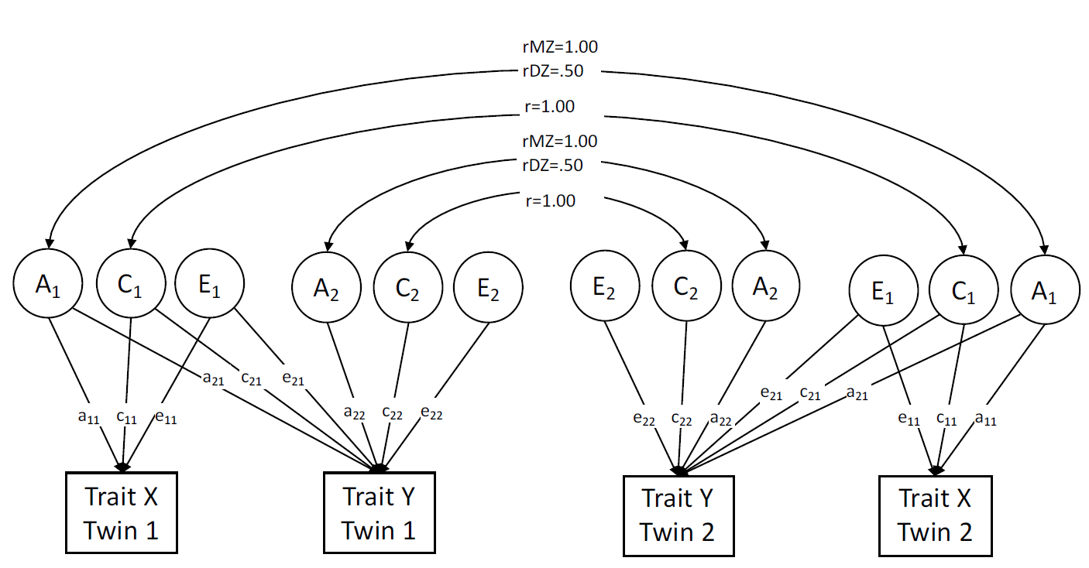
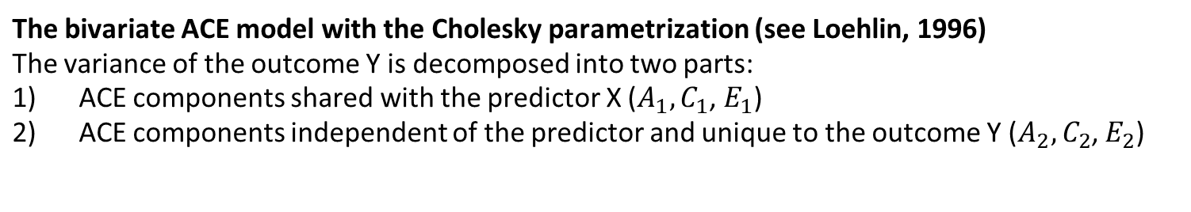
The bivariate twin model
The bivariate ACE model with the Cholesky parametrization (see Loehlin, 1996)
The variance of the outcome Y is decomposed into two parts:
ACE components shared with the predictor X ($A_{1},C_{1}$, $E_{1}$)
ACE components independent of the predictor and unique to the outcome Y ($A_{2},C_{2}$, $E_{2}$)

Slide 5
Introduction to the bivariate twin model
Why do we need bi-/multivariate ACE models?
Covariation between two (or more) traits is decomposed into genetic and environmental components in addition to trait specific variance decomoposition
  How much of the phenotypic correlation between traits is accounted for by genetic and environmental factors?
Bivariate heritability = proportion of covariance explained by genetic factors (de Vries et al. 2021)

Slide 6
Introduction to the bivariate twin model
Hence, we can adress the following questions with a multivariate twin model:
Why do traits covary?
  Trait Covariation/ Bivariate Heritability ( = genetic factors explaining trait covariation)
What factors account for/explain the heritability of Y?
  Trait correlation
...and many more questions, but let‘s concentrate on these two

Slide 7
2. Trait Covariation and Trait Correlation
The bivariate ACE model with the Cholesky parametrization (see Loehlin, 1996)
The variance of the outcome Y is decomposed into two parts:
ACE components shared with the predictor X ($A_{1},C_{1}$, $E_{1}$)
ACE components independent of the predictor and unique to the outcome Y ($A_{2},C_{2}$, $E_{2}$)

Slide 8

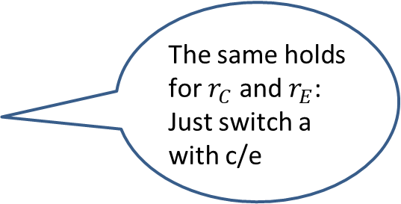


2. Trait Covariation and Trait Correlation
$$r_{A}$$
$$r_{A}$$
Example: Using path tracing rules or covariance algebra (see appendix), we can show that the genetic correlation is formally defined as:
r_{A} = Covariance due to shared genetic factors divided by the square root of the product of the genetic variances (see appendix!)
The same holds for $r_{C}$ and $r_{E}$: Just switch a with c/e
Notes:
No contradiction with common non-shared environmental factors
Common with respect to the variables
Shared with respect to the two twins

Slide 9
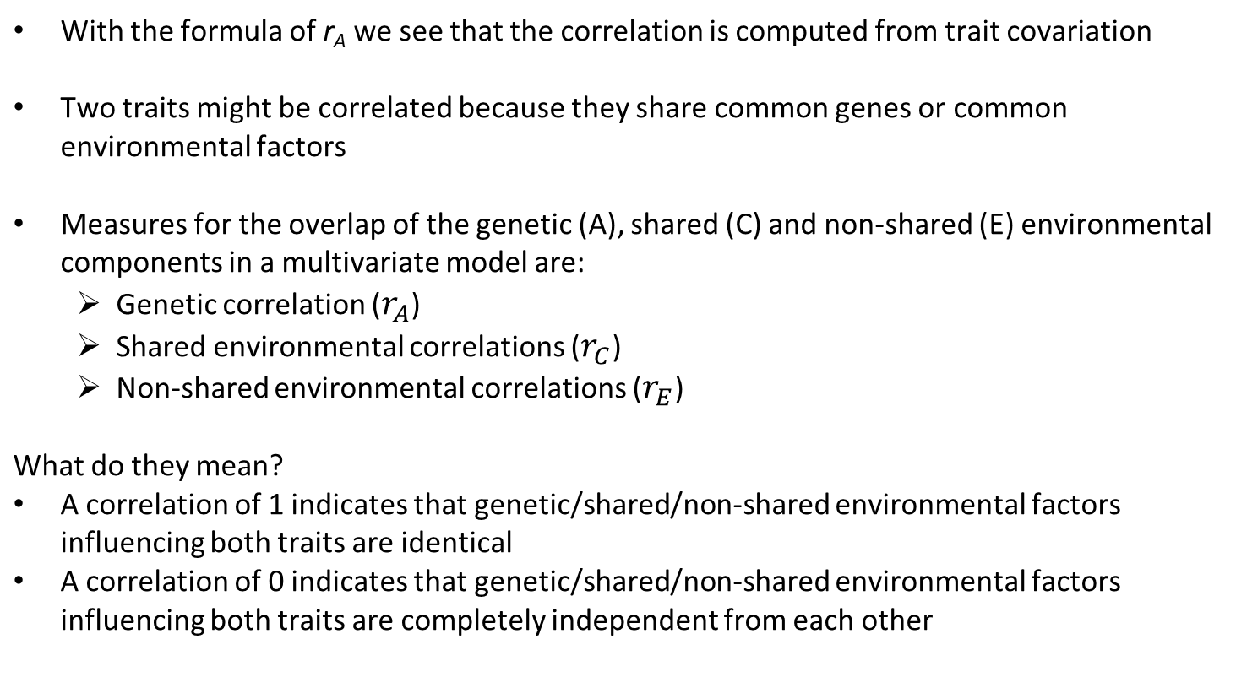
2. Trait Covariation and Trait Correlation
With the formula of r_{A} we see that the correlation is computed from trait covariation
Two traits might be correlated because they share common genes or common environmental factors
Measures for the overlap of the genetic (A), shared (C) and non-shared (E) environmental components in a multivariate model are:
  Genetic correlation ($r_{A}$)
  Shared environmental correlations ($r_{C}$)
  Non-shared environmental correlations ($r_{E}$)
What do they mean?
A correlation of 1 indicates that genetic/shared/non-shared environmental factors influencing both traits are identical
A correlation of 0 indicates that genetic/shared/non-shared environmental factors influencing both traits are completely independent from each other
Notes:
No contradiction with common non-shared environmental factors
Common with respect to the variables
Shared with respect to the two twins

Slide 10
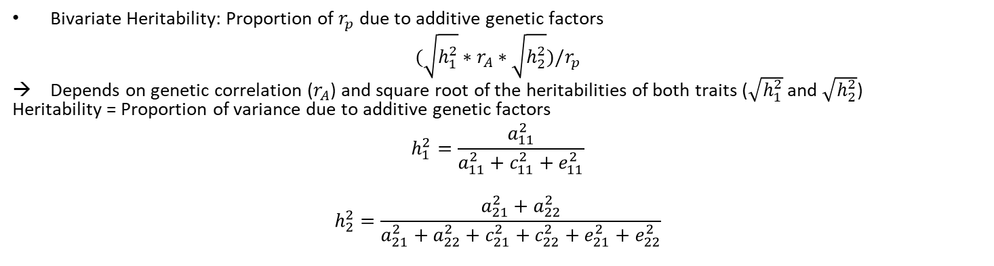


2. Trait Covariation and Trait Correlation
$$r_{A}$$
$$r_{A}$$
Bivariate Heritability: Proportion of $r_{p}$ due to additive genetic factors
$$(\sqrt{h_{1}^{2}}∗r_{A}∗\sqrt{h_{2}^{2}})/r_{p}$$
Depends on genetic correlation ($r_{A}$) and square root of the heritabilities of both traits ($\sqrt{h_{1}^{2}}$ and $\sqrt{h_{2}^{2}}$)
Heritability = Proportion of variance due to additive genetic factors
$$h_{1}^{2}=\frac{a_{11}^{2}}{a_{11}^{2}+c_{11}^{2}+e_{11}^{2}}$$
$$h_{2}^{2}=\frac{a_{21}^{2}+a_{22}^{2}}{a_{21}^{2}+a_{22}^{2}+c_{21}^{2}+c_{22}^{2}+e_{21}^{2}+e_{22}^{2}}$$
Notes:
No contradiction with common non-shared environmental factors
Common with respect to the variables
Shared with respect to the two twins

Slide 11
2. Trait Covariation and Trait Correlation
High influence of genetic factors on covariation (= high bivariate heritability), but low genetic correlation:
  Genes play important role in observed overlap (covariation) between two traits, but most of the genetic influences are trait specific
Small influence of genetic factors on covariation (= low bivariate heritability), but substantial genetic correlation:
  Set of genes influencing each trait are shared to large extent, but genes are not that important for the association between the two traits
See de Vries et al. (2021) for an applied example!

Slide 12
2. Trait Covariation and Trait Correlation
Use of genetic correlations of traits
Genetic correlations of traits can be compared to, or provide reference for, genetically informative analyses based on molecular genetic data (e.g., summary statistics of large Genome Wide Association Studies, GWAS)
  First indicators of genetic overlap between traits
Genetic and environmental correlations reflect the overlap of genetic and environmental factors over time (e.g., Kan et al. 2013; Baselmans et al. 2018)
  Stability of genetic influences on development of a trait over time can be investigated (longitudinal perspective)
  Example: bivariate heritabiliy and genetic correlations between measurements of anxiety and depression symptoms across the life span (Nivard et al., 2014)
Notes:
No contradiction with common non-shared environmental factors
Common with respect to the variables
Shared with respect to the two twins

Slide 13
2. Trait Covariation and Trait Correlation
For a substantial correlation between traits (e.g., comorbidity between disorders), a multivariate ACE model can delineate genetic and environmental contribution to this association (Røysamb and Tambs, 2016)
For example, in case of the two disorders anxiety and depression, twin studies revealed that genetic factors are a major source of covariation and environmental factors are rather important for the uniqueness of the two conditions (Kendler et al., 1992, 2006)

Slide 14
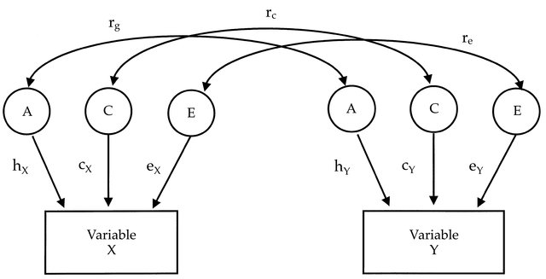
3. Variants of the bivariate model
Common variants of the bivariate model
There are different ways to conceptualize the structure of genetic (A), shared environmental (C) and non-shared environmental (E) factors
The here presented models can all be estimated using the “umx” package, for further details see Bates, Maes and Neale (2019)
See Roysamb and Tambs (2016) for more model types and explanations
The common factor model tests the hypothesis that effects (A, C and E) are mediated through one common phenotypic factor
Cholesky Model
…see previous slides of this presentation
Correlated factor model
Common factor model
Source:https://www.researchgate.net/publication/295999071_A_longitudinal_twin_study_of_specific_cognitive_abilities_in_preschool_children/figures?lo=1

Slide 15
4. Factors explaining the heritability of a trait
Example:
There is no gene for education. So, why is education so heritable?

Slide 16
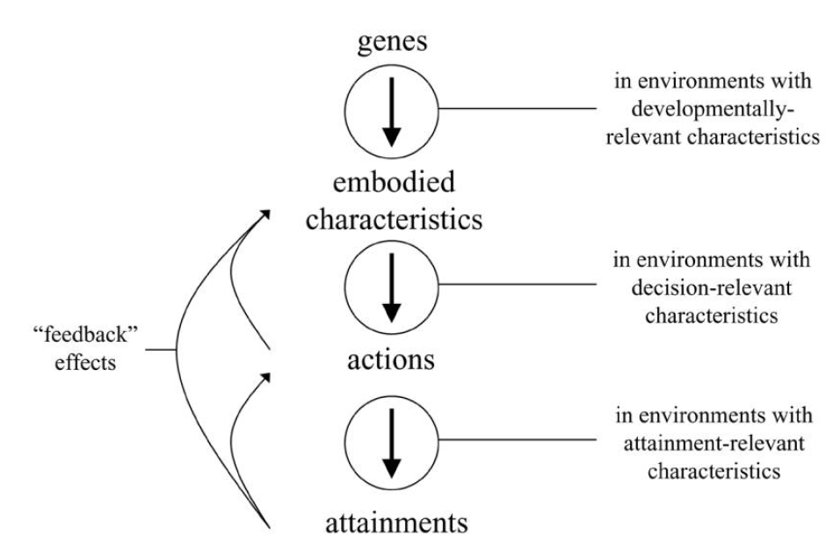
4. Factors explaining the heritability of a trait
Figure 1: How genes affect social outcomes (modified adaption from Freese (2008)
with no feedback effects)

Slide 17
4. Factors explaining the heritability of a trait
Variables
Concepts
A
(Non-)cognitive abilities, personality, …
Learning behavior and motivation, parent‘s/teacher‘s expectations
Education, Occupational status, Income
Figure 1: How genes affect social outcomes (modified adaption from Freese (2008)
with no feedback effects)

Slide 18
4. Factors explaining the heritability of a trait
Variables
Concepts
Opportunity to moderate the genetic effect at different levels (GxE).
Different time points along the genetic effect – maybe with different results?
A
(Non-)cognitive abilities, personality, …
Learning behavior and motivation, parent‘s/teacher‘s expectations
Education, Occupational status, Income
Figure 1: How genes affect social outcomes (modified adaption from Freese (2008)
with no feedback effects)

Slide 19
5. Explaining the heritability of a trait: The case of gene-environment correlations (rGE)
Commonly, three types of rGE are distinguished (Plomin et al. 1977):
Passive rGE: Parents pass their genes to their children and manipulate their rearing environment, leading to a correlation between children‘s genotype and their rearing environment
Active rGE: Individuals select themselves into environments based on their genotype, leading to a correlation between the individual‘s genotype and the environmental exposure
Evocative rGE: Individuals evoke reactions based on their genotype, leading to a correlation between the individual‘s genotype and the environmental response

Slide 20
5. Explaining the heritability of a trait: The case of gene-environment correlations (rGE)
In multivariate twin models, we can analyze rGE processes
Example: Research shows consistently that „environmental“ variables, like parenting or the work environment, are heritable
This can be explained by rGE processes:
  Children evoke parental reactions based on their genotype and/or genetic influenced traits
  Adults select themselves into work environments based on their genotype and/or genetic influenced traits
To examine these genetic influenced traits is the same procedure as when we try to explain the heritability of X!

Slide 21
6. Outlook 1: ACE-beta model
One drawback of the bi- and multivariate ACE models in the Cholesky parametrization is that no phenotypic effects are estimated
We might know that some of the heritability of Y is accounted for by genes affecting X
We don‘t know through which phenotype this genetic effect is mediated, i.e. we don‘t know the „phenotypic bottle-neck“ (Freese, 2008)
This can be investigated with the ACE-beta model (Kohler et al., 2011) which will be covered in an advanced workshop, if you are interested!

Slide 22
Outlook 1: ACE-beta model
?
?
Example:
Some part of the heritability of education is accounted for by genes associated with cognitive ability (A1). Is the effect exclusively mediated via cognitive ability? Or are there other traits (e.g.,non-cognitive skills) that are also affected by A1 and have a phenotypic effect on education?
Notes:
Both seems plausible, but we don‘t know until we include phenotypic effects into the ACE models.

Slide 23
Outlook 2: GxE analyses
As the genetic path model by Freese (2008) suggests and evidence confirms:
The (mediation of) genetic effects take place in and thus might be moderated by broader environments
Example:
To realize your genetic potential for education there need to be enough resources

Slide 24
7. Applied data analysis in R
Now, we will see how we can estimate bi-/multivariate ACE models in R using the package umx.
Notes:
No contradiction with common non-shared environmental factors
Common with respect to the variables
Shared with respect to the two twins

Slide 25
Literature
Baselmans, B. M. L., Willems, Y. E., Van Beijsterveldt, C. E. M., Ligthart, L., Willemsen, G., Dolan, C. V., Boomsma, D. I., & Bartels, M. (2018). Unraveling the genetic and environmental relationship between Well-Being and Depressive symptoms throughout the lifespan. Frontiers in Psychiatry, 9. https://doi.org/10.3389/fpsyt.2018.00261
Bates, T. C., Maes, H. H., & Neale, M. C. (2019). umx: Twin and Path-Based Structural Equation Modeling in R. Twin Research and Human Genetics, 22(1), 27–41. https://doi.org/10.1017/thg.2019.2
de Vries, L. P., Van Beijsterveldt, T. C. E. M., Maes, H., Colodro-Conde, L., & Bartels, M. (2021). Genetic Influences on the Covariance and Genetic Correlations in a Bivariate Twin Model: An Application to Well-Being. Behavior Genetics, 51, 191–203. https://doi.org/10.1007/s10519-021-10046-y
Freese, J. (2008). Genetics and the social science explanation of individual outcomes. American Journal of Sociology, 114(S1), S1–S35. https://doi.org/10.1086/592208
Kan, K., Dolan, C. V., Nivard, M. G., Middeldorp, C. M., Van Beijsterveldt, C. E. M., Willemsen, G., & Boomsma, D. I. (2013). Genetic and Environmental Stability in Attention Problems Across the Lifespan: Evidence From the Netherlands Twin Register. Journal of the American Academy of Child & Adolescent Psychiatry, 52(1), 12–25. https://doi.org/10.1016/j.jaac.2012.10.009

Slide 26
Literature
Kendler, K. S., Gardner, C. O., Gatz, M., & Pedersen, N. L. (2006). The sources of co-morbidity between major depression and generalized anxiety disorder in a Swedish national twin sample. Psychological Medicine, 37(3), 453–462. https://doi.org/10.1017/s0033291706009135
Kendler, K. S., Neale, M. C., Kessler, R. C., Heath, A. C., & Eaves, L. J. (1992). Major depression and generalized anxiety disorder: same genes, (partly) different environments? Archives of General Psychiatry, 49(9), 716-722. https://doi.org/10.1001/archpsyc.1992.01820090044008
Kohler, H.-P., Behrman, J. R., & Schnittker, J. (2011). Social Science Methods for Twins Data: Integrating Causality, Endowments, and Heritability. Biodemography and Social Biology, 57(1), 88–141. https://doi.org/10.1080/19485565.2011.580619
Loehlin, J. C. (1996). The Cholesky approach: A cautionary note. Behavior Genetics, 26(1), 65–69. https://doi.org/10.1007/bf02361160
Nivard, M. G., Dolan, C. V., Kendler, K. S., Kan, K. J., Willemsen, G., Van Beijsterveldt, C. E. M., Lindauer, R. J. L., Van Beek, J. H. D. A., Geels, L. M., Bartels, M., Middeldorp, C. M., & Boomsma, D. I. (2014). Stability in symptoms of anxiety and depression as a function of genotype and environment: a longitudinal twin study from ages 3 to 63 years. Psychological Medicine, 45(5), 1039–1049. https://doi.org/10.1017/s003329171400213x

Slide 27
Literature
Plomin, R., DeFries, J. C., Knopik, V. S., & Neiderhiser, J. M. (2013). Behavioral genetics (Sixth Edition). Worth Publishers.
Plomin, R., DeFries, J. C., & Loehlin, J. C. (1977). Genotype-environment interaction and correlation in the analysis of human behavior. Psychological Bulletin, 84(2), 309–322. https://doi.org/10.1037/0033-2909.84.2.309
Røysamb, E., & Tambs, K. (2016). The beauty, logic and limitations of twin studies. Norsk Epidemiologi, 26(1–2). https://doi.org/10.5324/nje.v26i1-2.2014

Slide 28
Appendix

Slide 29
Appendix: Path tracing rules and covariance algebra
In Behavioral Genetics, there are a lot of „secondary“ statistics, like heritability, genetic correlation or genetic/environmental variance.
You can compute these statistics with your model parameters, e.g. in the Cholesky parametrization the path coefficients. But, how?
There are a lot of techniques. Two of them are presented here:
1) Path tracing rules and
2) Covariance algebra

Slide 30
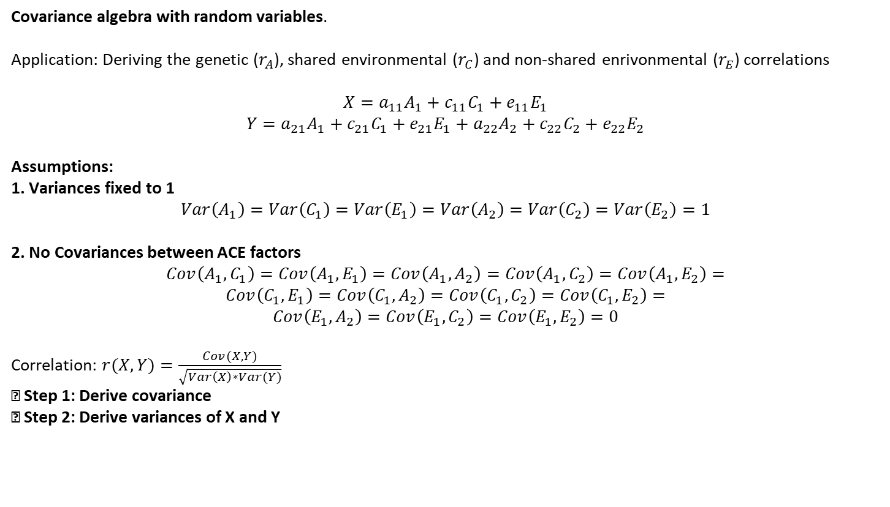
Appendix: Path tracing rules and covariance algebra
Covariance algebra with random variables.
Application: Deriving the genetic ($r_{A}$), shared environmental ($r_{C}$) and non-shared enrivonmental ($r_{E}$) correlations
$$X=a_{11}A_{1}+c_{11}C_{1}+e_{11}E_{1}$$
$$Y=a_{21}A_{1}+c_{21}C_{1}+e_{21}E_{1}+a_{22}A_{2}+c_{22}C_{2}+e_{22}E_{2}$$
Assumptions:
1. Variances fixed to 1
$$Var\left(A_{1}\right)=Var\left(C_{1}\right)=Var\left(E_{1}\right)=Var\left(A_{2}\right)=Var\left(C_{2}\right)=Var\left(E_{2}\right)=1$$
2. No Covariances between ACE factors
$$Cov\left(A_{1}, C_{1}\right)=Cov\left(A_{1}, E_{1}\right)=Cov\left(A_{1}, A_{2}\right)=Cov\left(A_{1}, C_{2}\right)=Cov\left(A_{1}, E_{2}\right)=$$
$$Cov\left(C_{1}, E_{1}\right)=Cov\left(C_{1}, A_{2}\right)=Cov\left(C_{1}, C_{2}\right)=Cov\left(C_{1}, E_{2}\right)=$$
$$Cov\left(E_{1}, A_{2}\right)=Cov\left(E_{1}, C_{2}\right)=Cov\left(E_{1}, E_{2}\right)=0$$
Correlation: $r(X,Y)=\frac{Cov(X,Y)}{\sqrt{Var\left(X\right)∗Var(Y)}}$
→ Step 1: Derive covariance
→ Step 2: Derive variances of X and Y

Slide 31
Appendix: Path tracing rules and covariance algebra
Path tracing rules (Wright 1934): Some rules to derive
the model implied (co-)variances
The covariance between two variables equals the sum of
the compound paths connecting them.
Remember: A variance is a covariance with itself!
There are three steps:
1. Obtain a compound path:
Trace backwards, change at a two-headed arrow, then trace forwards
Never go forward and then backward
Never pass out of one arrow head into another arrowhead (only heads-tails/tails-heads, never heads-heads)
Every compund path must contain only one bidirectional arrow (i.e., variance or covariance)
2. Compute the product of the parameters belonging to one compound path
3. Sum over all different compound paths. Compound paths are considered different if they contain a) different parameters or b) same parameters in a different order!
See: https://www.youtube.com/watch?v=wBtLyi1u4bk&list=PLliBbGBc5nn3tQiIBHFd-YvWK6dXb4ryr&index=3

Slide 32
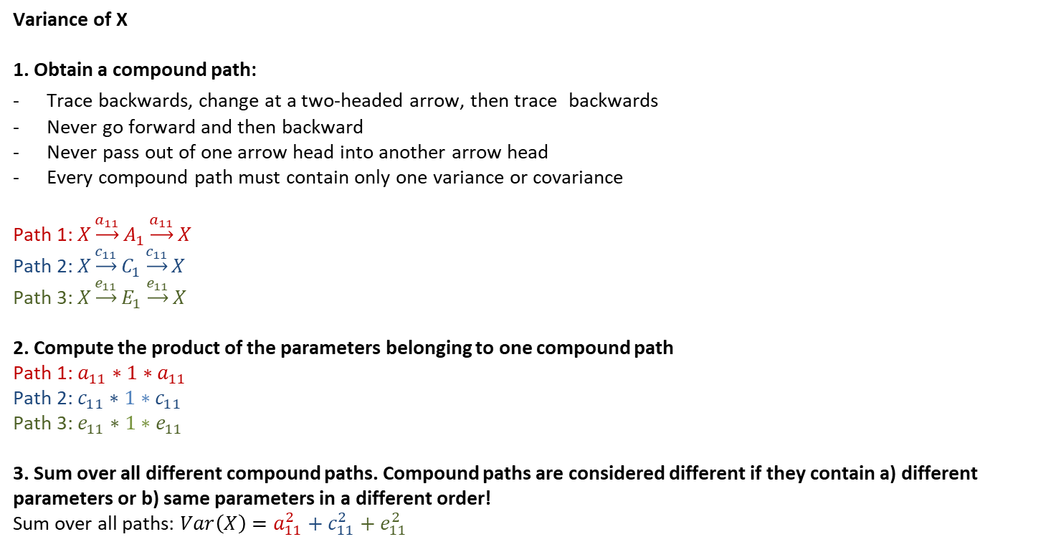
Appendix: Path tracing rules and covariance algebra
Variance of X
1. Obtain a compound path:
Trace backwards, change at a two-headed arrow, then trace backwards
Never go forward and then backward
Never pass out of one arrow head into another arrow head
Every compound path must contain only one variance or covariance
Path 1: $X\underset{→}{a_{11}}A_{1}\underset{→}{a_{11}}X$
Path 2: $X\underset{→}{c_{11}}C_{1}\underset{→}{c_{11}}X$
Path 3: $X\underset{→}{e_{11}}E_{1}\underset{→}{e_{11}}X$
2. Compute the product of the parameters belonging to one compound path
Path 1: $a_{11}∗1∗a_{11}$
Path 2: $c_{11}∗1∗c_{11}$
Path 3: $e_{11}∗1∗e_{11}$
3. Sum over all different compound paths. Compound paths are considered different if they contain a) different parameters or b) same parameters in a different order!
Sum over all paths: $Var\left(X\right)=a_{11}^{2}+c_{11}^{2}+e_{11}^{2}$

Slide 33
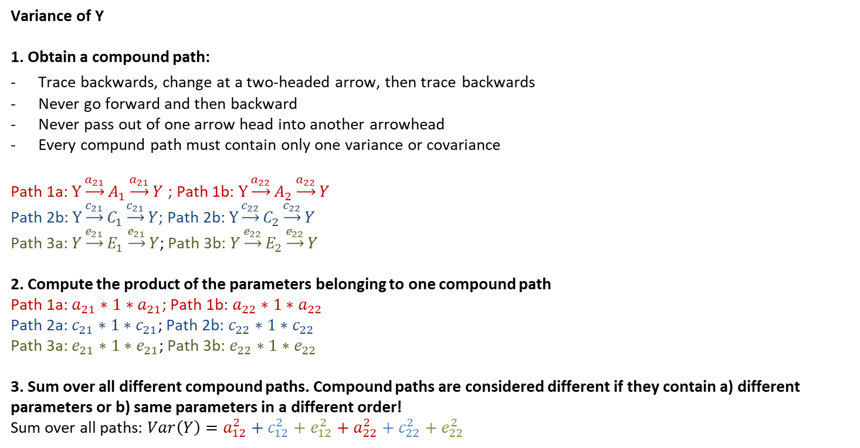
Appendix: Path tracing rules and covariance algebra
Variance of Y
1. Obtain a compound path:
Trace backwards, change at a two-headed arrow, then trace backwards
Never go forward and then backward
Never pass out of one arrow head into another arrowhead
Every compund path must contain only one variance or covariance
Path 1a: $Y\underset{→}{a_{21}}A_{1}\underset{→}{a_{21}}Y$ ; Path 1b: $Y\underset{→}{a_{22}}A_{2}\underset{→}{a_{22}}Y$
Path 2b: $Y\underset{→}{c_{21}}C_{1}\underset{→}{c_{21}}Y$; Path 2b: $Y\underset{→}{c_{22}}C_{2}\underset{→}{c_{22}}Y$
Path 3a: $Y\underset{→}{e_{21}}E_{1}\underset{→}{e_{21}}Y$; Path 3b: $Y\underset{→}{e_{22}}E_{2}\underset{→}{e_{22}}Y$
2. Compute the product of the parameters belonging to one compound path
Path 1a: $a_{21}∗1∗a_{21}$; Path 1b: $a_{22}∗1∗a_{22}$
Path 2a: $c_{21}∗1∗c_{21}$; Path 2b: $c_{22}∗1∗c_{22}$
Path 3a: $e_{21}∗1∗e_{21}$; Path 3b: $e_{22}∗1∗e_{22}$
3. Sum over all different compound paths. Compound paths are considered different if they contain a) different parameters or b) same parameters in a different order!
Sum over all paths: $Var\left(Y\right)=a_{12}^{2}+c_{12}^{2}+e_{12}^{2}+a_{22}^{2}+c_{22}^{2}+e_{22}^{2}$

Slide 34
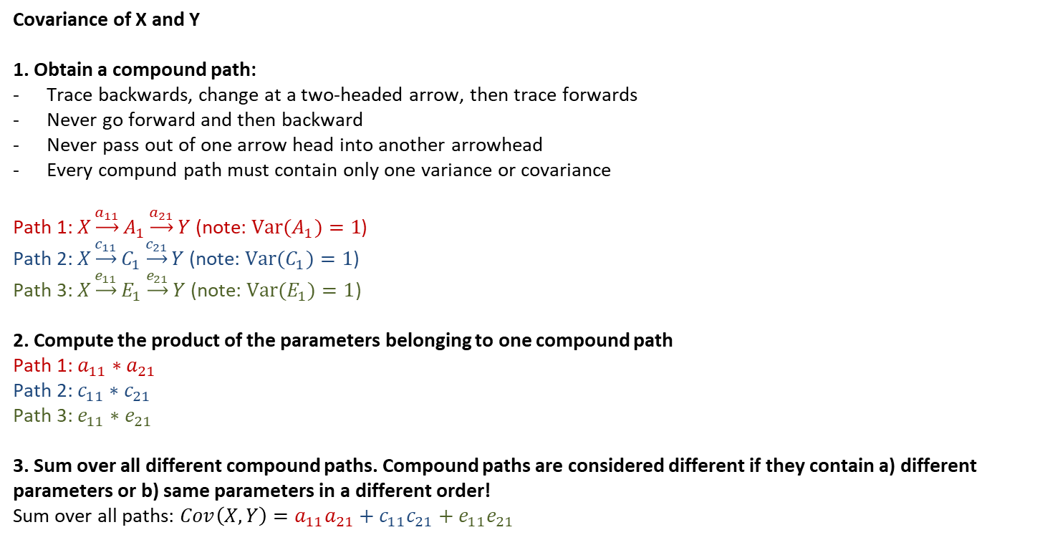
Appendix: Path tracing rules and covariance algebra
Covariance of X and Y
1. Obtain a compound path:
Trace backwards, change at a two-headed arrow, then trace forwards
Never go forward and then backward
Never pass out of one arrow head into another arrowhead
Every compund path must contain only one variance or covariance
Path 1: $X\underset{→}{a_{11}}A_{1}\underset{→}{a_{21}}Y$ (note: $Var(A_{1})=1$)
Path 2: $X\underset{→}{c_{11}}C_{1}\underset{→}{c_{21}}Y$ (note: $Var(C_{1})=1$)
Path 3: $X\underset{→}{e_{11}}E_{1}\underset{→}{e_{21}}Y$ (note: $Var(E_{1})=1$)
2. Compute the product of the parameters belonging to one compound path
Path 1: $a_{11}∗a_{21}$
Path 2: $c_{11}∗c_{21}$
Path 3: $e_{11}∗e_{21}$
3. Sum over all different compound paths. Compound paths are considered different if they contain a) different parameters or b) same parameters in a different order!
Sum over all paths: $Cov\left(X,Y\right)=a_{11}a_{21}+c_{11}c_{21}+e_{11}e_{21}$

Slide 35
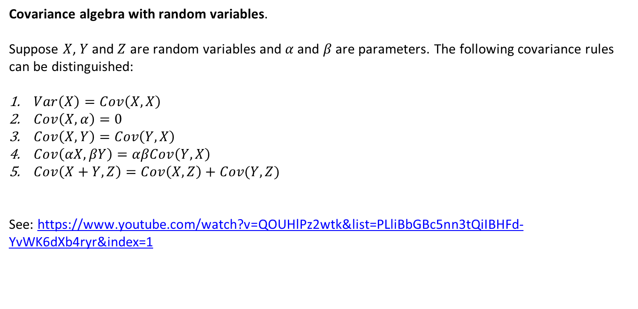
Appendix: Path tracing rules and covariance algebra
Covariance algebra with random variables.
Suppose $X$, $Y$ and $Z$ are random variables and $α$ and $β$ are parameters. The following covariance rules can be distinguished:
$Var\left(X\right)=Cov\left(X,X\right)$
$Cov\left(X,α\right)=0$
$Cov\left(X,Y\right)=Cov\left(Y,X\right)$
$Cov\left(αX,βY\right)=αβCov\left(Y,X\right)$
$Cov\left(X+Y,Z\right)=Cov\left(X,Z\right)+Cov(Y,Z)$
See: https://www.youtube.com/watch?v=QOUHlPz2wtk&list=PLliBbGBc5nn3tQiIBHFd-YvWK6dXb4ryr&index=1

Slide 36
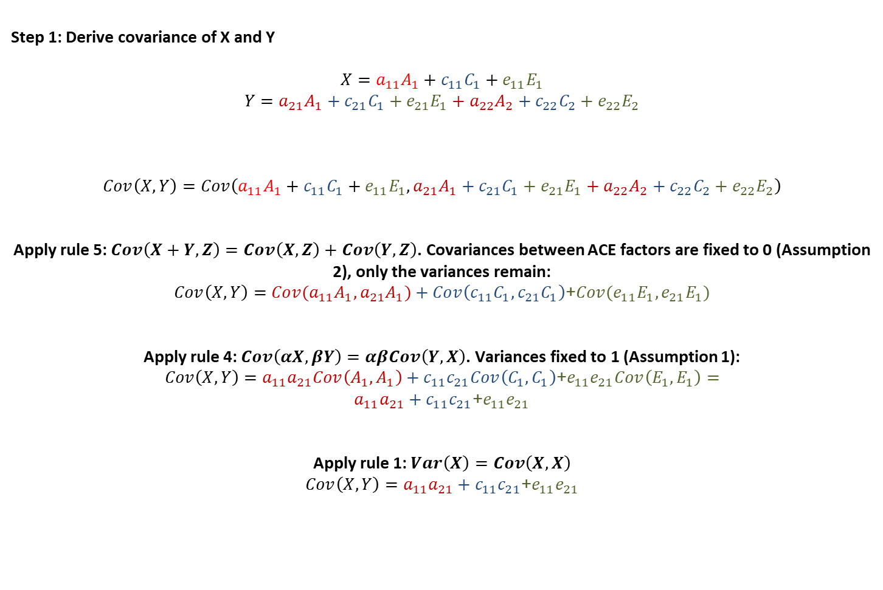
Appendix: Path tracing rules and covariance algebra
Step 1: Derive covariance of X and Y
$$X=a_{11}A_{1}+c_{11}C_{1}+e_{11}E_{1}$$
$$Y=a_{21}A_{1}+c_{21}C_{1}+e_{21}E_{1}+a_{22}A_{2}+c_{22}C_{2}+e_{22}E_{2}$$
$$Cov\left(X,Y\right)=Cov\left(a_{11}A_{1}+c_{11}C_{1}+e_{11}E_{1},a_{21}A_{1}+c_{21}C_{1}+e_{21}E_{1}+a_{22}A_{2}+c_{22}C_{2}+e_{22}E_{2}\right)$$
Apply rule 5: $Cov\left(X+Y,Z\right)=Cov\left(X,Z\right)+Cov\left(Y,Z\right)$. Covariances between ACE factors are fixed to 0 (Assumption 2), only the variances remain:
$$Cov\left(X,Y\right)=Cov(a_{11}A_{1},a_{21}A_{1})+Cov\left(c_{11}C_{1}, c_{21}C_{1}\right)\text{+}Cov(e_{11}E_{1}, e_{21}E_{1})$$
Apply rule 4: $Cov\left(αX,βY\right)=αβCov\left(Y,X\right)$. Variances fixed to 1 (Assumption 1):
$$Cov\left(X,Y\right)=a_{11}a_{21}Cov\left(A_{1}, A_{1}\right)+c_{11}c_{21}Cov\left(C_{1}, C_{1}\right)\text{+}e_{11}e_{21}Cov\left(E_{1}, E_{1}\right)= \\ a_{11}a_{21}+c_{11}c_{21}\text{+}e_{11}e_{21}$$
Apply rule 1: $Var\left(X\right)=Cov\left(X,X\right)$
$$Cov\left(X,Y\right)=a_{11}a_{21}+c_{11}c_{21}\text{+}e_{11}e_{21}$$

Slide 37
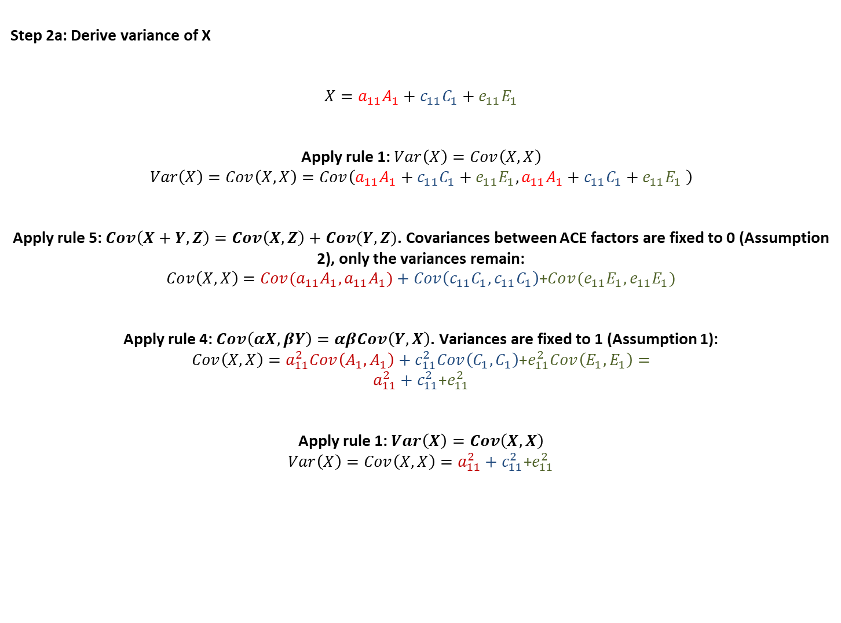
Appendix: Path tracing rules and covariance algebra
Step 2a: Derive variance of X
$$X=a_{11}A_{1}+c_{11}C_{1}+e_{11}E_{1}$$
Apply rule 1: $Var\left(X\right)=Cov\left(X,X\right)$
$$Var\left(X\right)=Cov\left(X,X\right)=Cov\left(a_{11}A_{1}+c_{11}C_{1}+e_{11}E_{1},a_{11}A_{1}+c_{11}C_{1}+e_{11}E_{1} \right)$$
Apply rule 5: $Cov\left(X+Y,Z\right)=Cov\left(X,Z\right)+Cov(Y,Z)$. Covariances between ACE factors are fixed to 0 (Assumption 2), only the variances remain:
$$Cov\left(X,X\right)=Cov(a_{11}A_{1},a_{11}A_{1})+Cov\left(c_{11}C_{1}, c_{11}C_{1}\right)\text{+}Cov(e_{11}E_{1}, e_{11}E_{1})$$
Apply rule 4: $Cov\left(αX,βY\right)=αβCov\left(Y,X\right)$. Variances are fixed to 1 (Assumption 1):
$$Cov\left(X,X\right)=a_{11}^{2}Cov\left(A_{1}, A_{1}\right)+c_{11}^{2}Cov\left(C_{1}, C_{1}\right)\text{+}e_{11}^{2}Cov\left(E_{1}, E_{1}\right)=$$
$$a_{11}^{2}+c_{11}^{2}\text{+}e_{11}^{2}$$
Apply rule 1: $Var\left(X\right)=Cov\left(X,X\right)$
$$Var\left(X\right)=Cov\left(X,X\right)=a_{11}^{2}+c_{11}^{2}\text{+}e_{11}^{2}$$

Slide 38
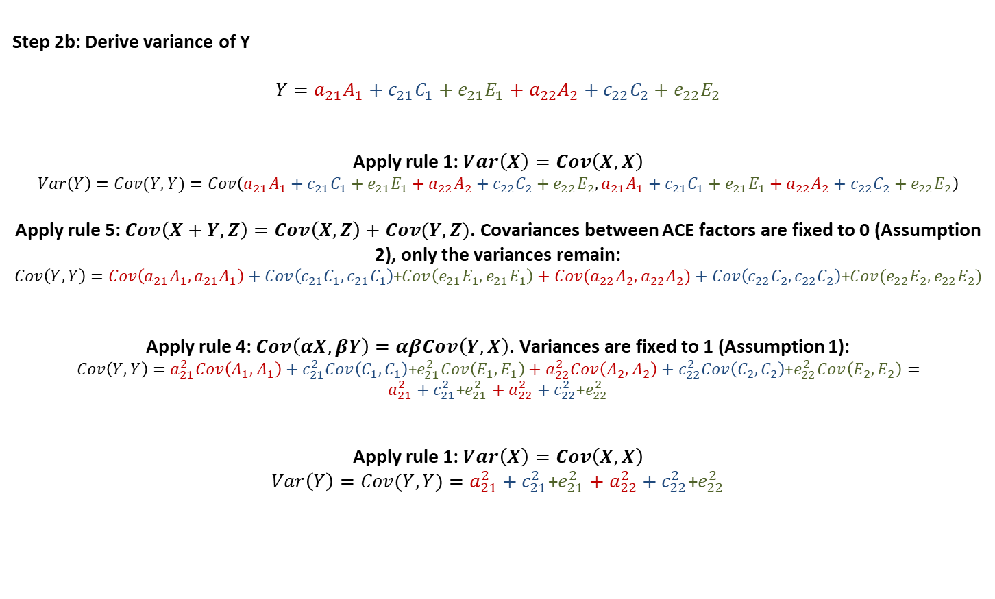
Appendix: Path tracing rules and covariance algebra
Step 2b: Derive variance of Y
$$Y=a_{21}A_{1}+c_{21}C_{1}+e_{21}E_{1}+a_{22}A_{2}+c_{22}C_{2}+e_{22}E_{2}$$
Apply rule 1: $Var\left(X\right)=Cov\left(X,X\right)$
$$Var\left(Y\right)=Cov(Y,Y)=Cov\left(a_{21}A_{1}+c_{21}C_{1}+e_{21}E_{1}+a_{22}A_{2}+c_{22}C_{2}+e_{22}E_{2},a_{21}A_{1}+c_{21}C_{1}+e_{21}E_{1}+a_{22}A_{2}+c_{22}C_{2}+e_{22}E_{2}\right)$$
Apply rule 5: $Cov\left(X+Y,Z\right)=Cov\left(X,Z\right)+Cov(Y,Z)$. Covariances between ACE factors are fixed to 0 (Assumption 2), only the variances remain:
$$Cov\left(Y,Y\right)=Cov\left(a_{21}A_{1},a_{21}A_{1}\right)+Cov\left(c_{21}C_{1}, c_{21}C_{1}\right)\text{+}Cov\left(e_{21}E_{1}, e_{21}E_{1}\right)+Cov(a_{22}A_{2},a_{22}A_{2})+Cov\left(c_{22}C_{2}, c_{22}C_{2}\right)\text{+}Cov(e_{22}E_{2}, e_{22}E_{2})$$
Apply rule 4: $Cov\left(αX,βY\right)=αβCov\left(Y,X\right)$. Variances are fixed to 1 (Assumption 1):
$$Cov\left(Y,Y\right)=a_{21}^{2}Cov\left(A_{1}, A_{1}\right)+c_{21}^{2}Cov\left(C_{1}, C_{1}\right)\text{+}e_{21}^{2}Cov\left(E_{1}, E_{1}\right)+a_{22}^{2}Cov\left(A_{2}, A_{2}\right)+c_{22}^{2}Cov\left(C_{2}, C_{2}\right)\text{+}e_{22}^{2}Cov\left(E_{2}, E_{2}\right)=$$
$$a_{21}^{2}+c_{21}^{2}\text{+}e_{21}^{2}+a_{22}^{2}+c_{22}^{2}\text{+}e_{22}^{2}$$
Apply rule 1: $Var\left(X\right)=Cov\left(X,X\right)$
$$Var\left(Y\right)=Cov(Y,Y)=a_{21}^{2}+c_{21}^{2}\text{+}e_{21}^{2}+a_{22}^{2}+c_{22}^{2}\text{+}e_{22}^{2}$$

Slide 39
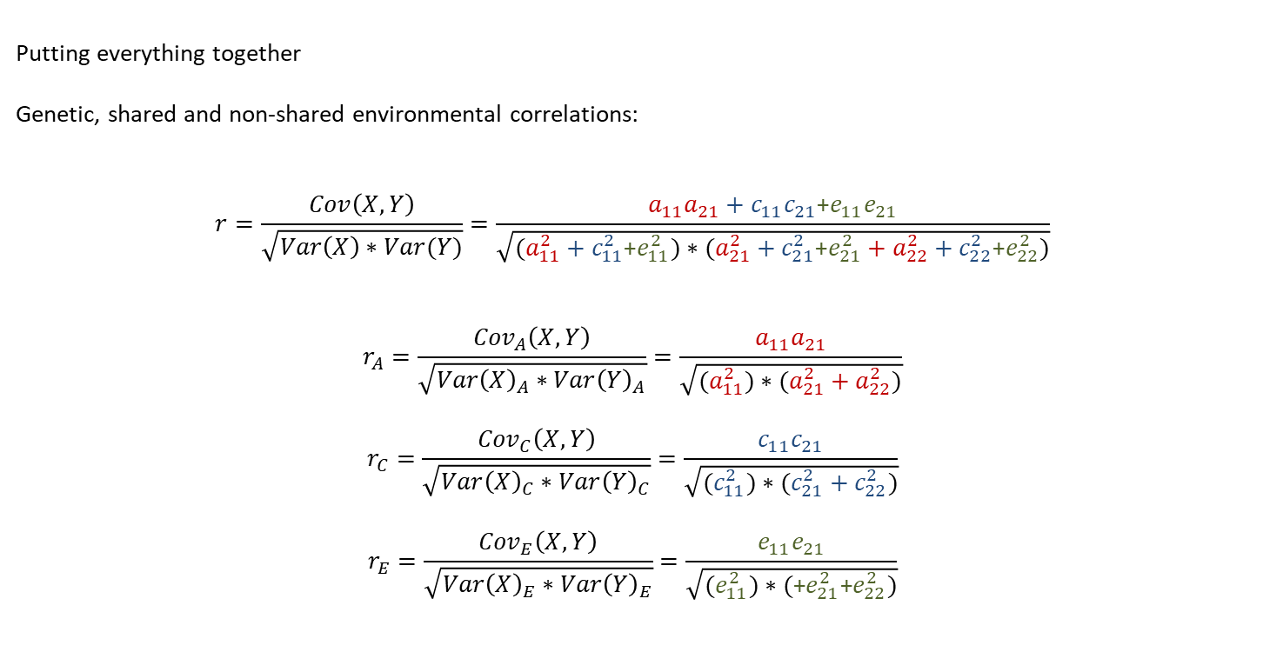
Appendix: Path tracing rules and covariance algebra
Putting everything together
Genetic, shared and non-shared environmental correlations:
$$r=\frac{Cov\left(X,Y\right)}{\sqrt{Var\left(X\right)∗Var(Y)}}=\frac{a_{11}a_{21}+c_{11}c_{21}\text{+}e_{11}e_{21}}{\sqrt{(a_{11}^{2}+c_{11}^{2}\text{+}e_{11}^{2})∗(a_{21}^{2}+c_{21}^{2}\text{+}e_{21}^{2}+a_{22}^{2}+c_{22}^{2}\text{+}e_{22}^{2})}}$$
$$r_{A}=\frac{{Cov}_{A}\left(X,Y\right)}{\sqrt{{Var\left(X\right)}_{A}∗{Var\left(Y\right)}_{A}}}=\frac{a_{11}a_{21}}{\sqrt{(a_{11}^{2})∗(a_{21}^{2}+a_{22}^{2})}}$$
$$r_{C}=\frac{{Cov}_{C}\left(X,Y\right)}{\sqrt{{Var\left(X\right)}_{C}∗{Var\left(Y\right)}_{C}}}=\frac{c_{11}c_{21}}{\sqrt{(c_{11}^{2})∗(c_{21}^{2}+c_{22}^{2})}}$$
$$r_{E}=\frac{{Cov}_{E}\left(X,Y\right)}{\sqrt{{Var\left(X\right)}_{E}∗{Var\left(Y\right)}_{E}}}=\frac{e_{11}e_{21}}{\sqrt{(e_{11}^{2})∗(\text{+}e_{21}^{2}\text{+}e_{22}^{2})}}$$

