Slide 1
Behavioral Genetic Data Analysis a workshop on the core concepts and statistical methods of behavioral genetics
August 17th and 18th, 2022
Lecturers: Dr. Bastian Mönkediek¹, Mirko Ruks¹, Theresa Rohm², Christoph Klatzka³ ¹ Bielefeld University, Bielefeld, Germany, ² University of Bremen, Bremen ³ Saarland University, Saarbruecken, Germany

Slide 2
Session 3:
Univariate ACE –Models

Slide 3
Twin Correlations
The Classical Twin Design (CTD) compares the similarities in a trait across monozygotic (MZ) and dizygotic (DZ) twin pairs.
The interclass-correlations (ICC) (rMZ,rDZ) can be split up in different compoents: heritability (h²) and shared environments (C²)
$r_{MZ}=h^{2}+{C_{MZ}}^{2}$ (1) $$r_{DZ}=0.5 h^{2}+{C_{DZ}}^{2} (2)$$
$${{Assumption: C}_{MZ}}^{2}={C_{DZ}}^{2}(called Equal Environment Assumption)$$
Combining the equations results in:
$$r_{DZ}={0.5h}^{2}+r_{MZ}−h^{2} \left(3\right)$$
$$0.5 h^{2}=r_{MZ}−r_{DZ} \left(4\right)$$
$$h^{2}={2(r}_{MZ}−r_{DZ}) \left(5\right)$$

Slide 4
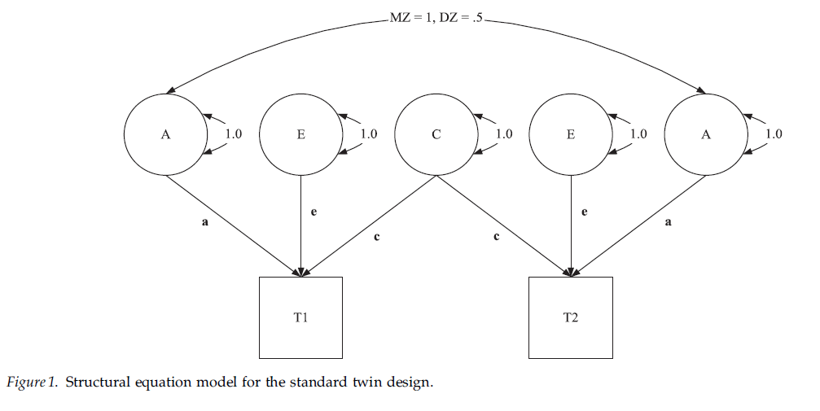
The Classical Univariate Model (SEM representation, wide format)
Figure: Turkheimer et al. 2005: 1218
(one data row per twin pair/family)

Slide 5
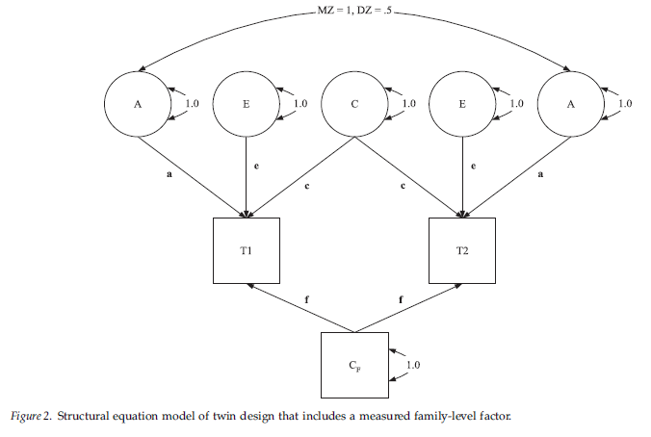
Twin Model with measured C
E.g. parents’ SES
Figure: Turkheimer et al. 2005: 1219

Slide 6
Twin Model with measured C
“Parental SES, for example, is necessarily the same for members of a twin pair assessed at the same point in time, so within the limited context of a study of twin children, it is a purely shared environmental measure. One would not want to conclude, however, that SES was in general a completely environmental variable, as it is well known that most purported measures of the environment include genetic variability (Plomin & Bergeman 1991); twin children are just not genetically informative about their parents’ SES.” (Turkheimer et al. 2005: 1219)

Slide 7
The Classical Univariate Model (Jöreskog, 2021; Mönkediek, 2022)
Traits of twin 1 (T1) and twin 2 (T2)
Correlation matrix
$$T_{1}$$
$$\left(1\right) T_{1}=μ_{1}+a_{1}A_{1}+c_{1}C_{1}+E_{1}$$
$$T_{2}=μ_{2}+a_{2}A_{2}+c_{2}C_{2}+E_{2}$$
$A_{1}$ $C_{1} C_{2}$ $A_{2}$
$$Φ= \left(\begin{matrix}1 & & & \\ 0 & 1 & & \\ 0 & 1 & 1 & \\ x & 0 & 0 & 1\end{matrix}\right)$$
$$T_{2}$$
$A_{1}$ $C_{1} C_{2}$ $A_{2}$

Slide 8
The Classical Univariate Model (Jöreskog, 2021; Mönkediek, 2022)
Traits of twin 1 (T1) and twin 2 (T2)
Correlation matrix
$$T_{1}$$
$$\left(1\right) T_{1}=μ_{1}+a_{1}A_{1}+c_{1}C_{1}+E_{1}$$
$$T_{2}=μ_{2}+a_{2}A_{2}+c_{2}C_{2}+E_{2}$$
$A_{1}$ $C_{1} C_{2}$ $A_{2}$
$$Φ= \left(\begin{matrix}1 & & & \\ 0 & 1 & & \\ 0 & 1 & 1 & \\ x & 0 & 0 & 1\end{matrix}\right)$$
$$T_{2}$$
$A_{1}$ $C_{1} C_{2}$ $A_{2}$
E1 and E2: expected to be uncorrelated
A1 and A2: Genetic relatedness twins (MZ = 1, DZ = 0.5)
For MZ and DZ twin pairs: Correlation between C1 and C2 is expected to be 1

Slide 9
The Classical Univariate Model (Jöreskog, 2021; Mönkediek, 2022)
Traits of twin 1 (T1) and twin 2 (T2)
Correlation matrix
$$T_{1}$$
$$\left(1\right) T_{1}=μ_{1}+a_{1}A_{1}+c_{1}C_{1}+E_{1}$$
$$T_{2}=μ_{2}+a_{2}A_{2}+c_{2}C_{2}+E_{2}$$
$A_{1}$ $C_{1} C_{2}$ $A_{2}$
$$Φ= \left(\begin{matrix}1 & & & \\ 0 & 1 & & \\ 0 & 1 & 1 & \\ x & 0 & 0 & 1\end{matrix}\right)$$
$$T_{2}$$
$A_{1}$ $C_{1} C_{2}$ $A_{2}$
Variance-covariance matrix
(2) ${Cov}_{MZ}=\left(\begin{matrix}a^{2}+c^{2}+e^{2} & a^{2}+c^{2} \\ a^{2}+c^{2} & a^{2}+c^{2}+e^{2}\end{matrix}\right)$
$${Cov}_{DZ}=\left(\begin{matrix}a^{2}+c^{2}+e^{2} & {0.5a}^{2}+c^{2} \\ {0.5a}^{2}+c^{2} & a^{2}+c^{2}+e^{2}\end{matrix}\right)$$

Slide 10
The Classical Univariate Model (Mönkediek, 2022)
Calculating the twin correlations and the standardized variance components
(3) $rMZ= {a^{2}+c^{2}}/{(a^{2}+c^{2}+e^{2})}$
$rDZ= {{0.5a}^{2}+c^{2}}/{(a^{2}+c^{2}+e^{2})}$
(4) A = 2 * (rMZ - rDZ) = ${a^{2}}/{(a^{2}+c^{2}+e^{2})}$
(5) C = 2 * rDZ - rMZ = ${c^{2}}/{(a^{2}+c^{2}+e^{2})}$
(6) E = 1 – rMZ = ${e^{2}}/{(a^{2}+c^{2}+e^{2})}$

Slide 11
Assumptions of ACE decompositions
Genetic within twin-pair correlation of MZ twins is 1,
genetic within twin-pair correlation of DZ twins is .5
Genetic effects on phenotype are additive
= no epistasis, no interactions between effects of different genes
(otherwise assumed genetic correlation of DZ twins of .5 is wrong)
No gene-environment interactions or correlations (GxE or GEr)
(assumption can be relaxed by more complex GxE models or
non-parameteric ACE decompositions, Guo and Wang 2002)
Phenotype can be approximated by a normal distribution

Slide 12
Assumptions of ACE decompositions (cont.)
Equal environment assumption (EAA)
= Same environmental influences for MZ and DZ twins
(if environments for MZ twins are more similar, A tends to be
inflated/overestimated, in case of IQ studies show that violation
of EEA does not inflate A , Derks et al. 2006)

Slide 13
Assumptions of ACE decompositions (cont.)
Equal environment assumption (EAA)
= Same environmental influences for MZ and DZ twins
(if environments for MZ twins are more similar, A tends to be
inflated/overestimated, in case of IQ studies show that violation
of EEA does not inflate A , Derks et al. 2006)
“Even if violations occur, these do not necessarily affect estimations, as long as differential treatment of MZ and DZ twins is unrelated or only weakly related to a trait under study; this is referred to as the ‘trait-relevant’ definition of EEA (LoParo & Waldman 2014: 611).” (Mönkediek 2021: 116)

Slide 14
Ways to Test EEA (Mönkediek 2021:121-124)
Compare the impact of twins’ actual and perceived zygosity on trait similarity [However: number of misperceived twins often small]
Investigate in how far the physical resemblance between twins leads to differences in how MZ and DZ twins are treated. [However: greater trait similarity in DZ twins can relate to greater genetic similarity -> gene-environment interplay (GxE or rGE)]
Determine the extent to which environmental similarity in MZ twins is initiated by others. [However: requires additional information]

Slide 15
Ways to Test EEA (cont.) (Mönkediek 2021:123)
Use multivariate data on DZ twins for more than one trait variable and calculate the shared environmental correlation in DZ twins for these phenotypic traits.
“[…] evaluate the associations between similarities in twins’ environments and trait similarities within zygosity groups.” (p. 123)
“[…] compare the similarity of how parents report the way they treat their twins with the similarities in the twins’ traits for MZ and DZ twin pairs” (p. 123)

Slide 16
Assumptions of ACE decompositions (cont.)
Equal environment assumption (EAA)
= Same environmental influences for MZ and DZ twins
(if environments for MZ twins are more similar, A tends to be
inflated/overestimated, in case of IQ studies show that violation
of EEA does not inflate A , Derks et al. 2006)
No assortative mating
= no positive correlation of parents regarding the phenotype
(possible correction using parents of twins-model or
correction formula of Loehlin et al., 2009: 0.5 + 0.5 * h₀² * r_{p}
with h₀² the heritability (share of A) given no assortative mating and
r_{p} the correlation of parents with respect to the phenotype)

Slide 17
Assumptions of ACE decompositions (cont. 2)
if all assumptions are met,
phenotype can be linear additively decomposed:
A + C + E with E including measurement error
This can be done using structural equation modeling
and “wide” formatted data
(one data row per twin pair/family),
But also using multilevel mixed-effects modeling
and “long” formatted data
(one data row per twin/person/person-year)

Slide 18
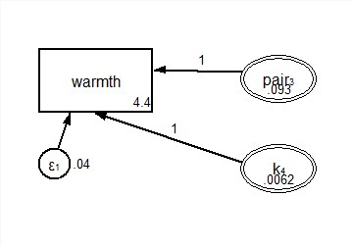
ACE Model long format (multilevel SEM)
C
Variables that define the data hierarchy:
-> ‘k’ varies across zygosity (nested in ‘pair’)
-> ‘pair’ varies between families
E
A
In stata: you can use the acelong command (ado-file)

Slide 19
Variation in ACE by sample size
Share variance components
Original sample
Random exclusion of pairs
N twins

Slide 20
Session 3:
Implementation in R

Slide 21
Implementation in R: Preparation
To load data-sets prepared in Stata into R:
install.packages("haven")
library(haven)
Using the twinflex-Package (by Mirko Ruks)
devtools::install_github('mirkoruks/twinflex') library(twinflex)
https://github.com/mirkoruks/twinflex

Slide 22
Implementation in R: Preparation
Important packages:
install.packages("OpenMx")
library(OpenMx) install.packages(" tidyverse")
library(tidyverse)
ALWAYS update your R version and all packages (results may change when a version is updated)

Slide 23
Implementation in R: getting help
AFTER you loaded the library you can use
help(twinflex)
to get the help-screen with all information on
the twinflex-command!

Slide 24
Univariate ACE model: continious
Run model univ_cont_tf <- twinflex(acevars = „VAR", data = dataset, sep = "_")
Show output summary(univ_cont_tf)

Slide 25
Model with covariates: continious
Check model includes only valid cases CovData <- data %>% filter(!is.na(sex) & !is.na(age))
Run model univ_cont_tf_covars <- twinflex(acevars = " VAR", data = CovData, sep = "_", covvars = c("age","sex"), covariance = FALSE )
Show output summary(univ_cont_tf_covars)
%>% - part of the „tidyverse“ – package (makes life easier!)

Slide 26
Univariate ACE model: continious
binary DV univ_bin_tf <- twinflex(acevars = „VARbin", ordinal = "IQbin", data = data, sep = "_")
ordinal DV univ_ord_tf <- twinflex(acevars = „VARord", ordinal = "IQord", data = data, sep = "_")

Slide 27
Drop parameters
Check which model fits the data best: modelAE <- omxSetParameters(multi_GxE_chol_tf, labels= c(‘labelold‘, ‘labelold‘), free=FALSE, values=0) modelfitAE <- mxRun(modelAE) modelfitAE <- mxTryHard(modelAE)
Show output summary(modelfitAE)

Slide 28
Implementation in R: Preparation
To load data-sets prepared in Stata into R:
install.packages("readstata13")
library(readstata13)
Using the Umx-Package (Bates et al. 2019)
install.packages("umx") library(umx)
ALWAYS update your R version and all packages (results may change when a version is updated)

Slide 29
Implementation in R: getting help
AFTER you loaded the library you can use
help(umxACE)
to get the help-screen with all information on
the umx-command!
use the Paper by Bates et al. 2019
Look at the reference manual: https://cran.r-project.org/web/packages/umx/umx.pdf

Slide 30
Implementation in R: Preparation (cont.)
Load data-set prepared in Stata:
library(haven) data <- read_dta("ZA6701_person_wid1_v5-0-0.dta")
Create sub-data-sets for MZ and DZ twins
dz = subset(twinlife_data_wide, zyg0102 == 2)
mz = subset(twinlife_data_wide, zyg0102 == 1)
Variable that contains the information on the zygosity

Slide 31
Implementation in R: Preparation (cont.)
Load data-set prepared in Stata:
data <- read.dta13("data.dta")
Create sub-data-sets for MZ and DZ twins
dz = data[data$zyg0102 == "2",] mz = data[data$zyg0102 == "1",]
Two mistakes that sometimes create errors in R when you load your data from stata into R:
You need to delete the labels for the variable containing the information on the twins‘ zygosity
Make sure you only include cases with non-missing information on the zygosity

Slide 32
ACE-Model in R (using umx)
ACE = umxACE(selDVs = "VAR", sep = "", dzData = dz, mzData = mz, addStd = TRUE, addCI = TRUE,)
Basic command
Dependent variable
separator in twin variable names (it will automatically identify the info for the first and second twin)
Saves your model under a specific name

Slide 33
ACE-Model in R (using umx)
ACE = umxACE(selDVs = "VAR", sep = "", dzData = dz, mzData = mz, addStd = TRUE, addCI = TRUE,)
Identifies your MZ and DZ data-sets
adds the algebras to compute a std model (default).
adds intervals to compute Cis (default)

Slide 34
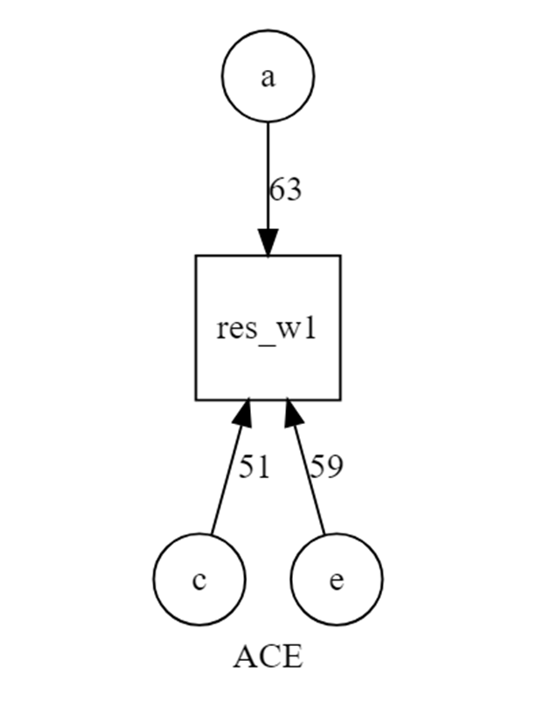
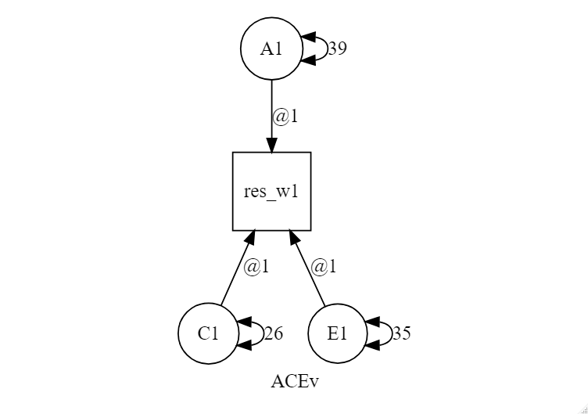
Graphical output
umxACE(…)
umxACEv(…)

Slide 35
Getting CIs
In order to get information on CIs you can use:
umxCI(ACE, run = "yes")

Slide 36
Check Model-Fit
To check whether an ACE, CE or ADE, or DE applies:
umxReduceACE(ACE)
your model‘s name
smallest value
Significant worse fit

Slide 37
Modify a path per hand
You can modify all path using umx:
umxModify(ACE, update = "c_r1c1", comparison = TRUE)
Your models name
Define path here
(You can also use: c(„PATHNAME",„PATHNAME“) to modify multiple path!)

Slide 38
ACE-Model in R (using umx)
ACE = umxACE(selDVs = "VAR", sep = "", dzData = dz, mzData = mz, addStd = TRUE, addCI = TRUE,)
Some more (useful) options:
type - to change the analysis method ("Auto", "FIML", "cov", "cor", "WLS", "DWLS", "ULS")
tryHard - uses mxTryHard (alternatives: "ordinal", "search“)
Notes:
TYPE: multivariate-normal full-information maximum likelihood (FIML); Weighted Least Squares (WLS)

Slide 39
ACE-Model in R (using umx)
ACE = umxACE(selDVs = "VAR", sep = "", dzData = dz, mzData = mz, addStd = TRUE, addCI = TRUE,)
Some more (useful) options:
type - to change the analysis method ("Auto", "FIML", "cov", "cor", "WLS", "DWLS", "ULS")
tryHard - uses mxTryHard (alternatives: "ordinal", "search“)
When used you need to set a seed; e.g.: set.seed(15)

Slide 40
ACE-Model in R (using umx)
ACE = umxACE(selDVs = "VAR", sep = "", dzData = dz, mzData = mz, addStd = TRUE, addCI = TRUE,)
Some more (useful) options:
type - to change the analysis method ("Auto", "FIML", "cov", "cor", "WLS", "DWLS", "ULS")
tryHard - uses mxTryHard (alternatives: "ordinal", "search“)
dzAr - DZ genetic correlation (defaults: 0.5). Vary to examine assortative mating.
dzCr - DZ "C" correlation (defaults: 1). Set to .25 to make an ADE model.

Slide 41
References
Bates, T. C., Maes, H., & Neale, M. C. (2019). umx: Twin and path-based structural equation modeling in R. Twin Research and Human Genetics, 22(1), 27-41. https://doi.org/10.1017/thg.2019.2
Derks, E. M., Dolan, C. V., & Boomsma, D. I. (2006). A test of the equal environment assumption (EEA) in multivariate twin studies. Twin Research and Human Genetics, 9(3), 403-411. https://doi.org/10.1375/twin.9.3.403
Guo, G., & Wang, J. (2002). The mixed or multilevel model for behavior genetic analysis. Behavior genetics, 32(1), 37-49. https://doi.org/10.1023/A:1014455812027
Jöreskog, K. G. (2021). Classical models for twin data. Structural Equation Modeling: A Multidisciplinary Journal, 28(1), 121-126. https://doi.org/10.1080/10705511.2020.1789465
Mönkediek, B. (2021). Trait-specific testing of the equal environment assumption: the case of school grades and upper secondary school attendance. Journal of Family Research, 33(1), 115-147. https://doi.org/10.20377/jfr-381

Slide 42
References
Mönkediek, B. (2022). How variants of tracking affect the role of genes and environment in explaining child attendance at upper secondary school. Research in Social Stratification and Mobility, 81, 100714. https://doi.org/10.1016/j.rssm.2022.100714
Turkheimer, E., D'Onofrio, B. M., Maes, H. H., & Eaves, L. J. (2005). Analysis and interpretation of twin studies including measures of the shared environment. Child Development, 76(6), 1217-1233. https://doi.org/10.1111/j.1467-8624.2005.00845.x-i1

