Slide 1




Behavioral Genetic Data Analysis a workshop on the core concepts and statistical methods of behavioral genetics
August 17th and 18th, 2022
Lecturers: Dr. Bastian Mönkediek¹, Mirko Ruks¹, Theresa Rohm², Christoph Klatzka³ ¹ Bielefeld University, Bielefeld, Germany ² Bremen University, Bremen, Germany ³ Saarland University, Saarbruecken, Germany
Notes:
Welcome to our workshop on behavioral genetic data analysis. We are glad so many of you are interested in learning something about behavioral genetics. Lets start with a quick introduction round.

Slide 2
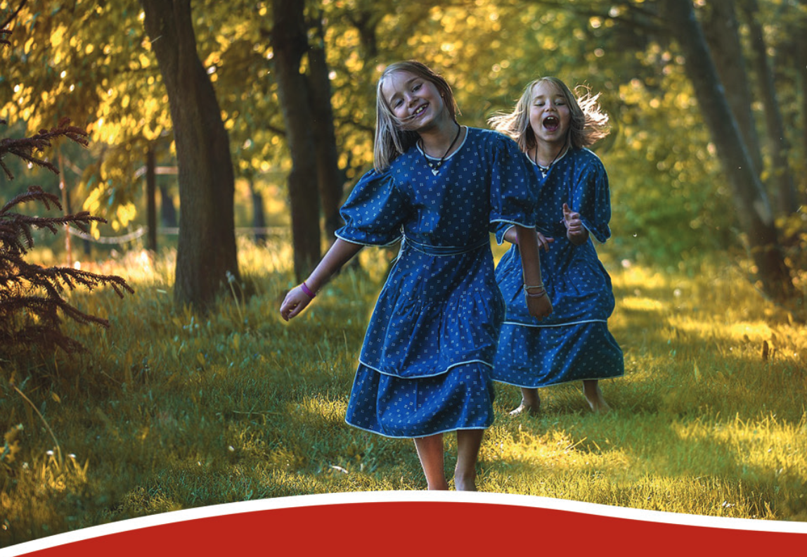

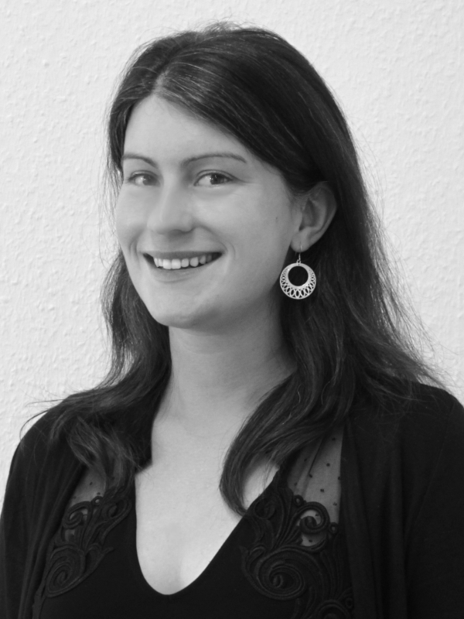




The TwinLife Team
Dr. Bastian Mönkediek
M.A. Theresa Rohm
M.Sc.-Psych. Christoph Klatzka
M.A. Mirko Ruks

Slide 3
Session 1:
Introduction to behavioral genetics

Slide 4
Behavioral genetics
Behavioral genetics seeks to use the powerful tools of genetics – twin and adoption studies as well as molecular genetic investigations – to characterize the origins of individual differences in behavior. These origins can lie in the genetic makeup, the environment and/or the complex interplay between them. (McGue & Gottesman, 2015)

Slide 5
Why twin studies?
„Twinning is an experiment of nature that produces identical twins, who are genetically identical, and fraternal twins who are only 50 percent similar genetically. If genetic factors are important for a trait, identical twins must be more similar.“ (Knopik et al. 2017, p. 87)
→ Twins are the perfect population to study genetic and environmental effects.
Notes:
Buch Seite 87

Slide 6
Short Recapitulation:
Basic knowledge on Genetics
Phenotype: Observed or measured trait or characteristic of an organism. (Also used to express all observable traits or characteristics of an organism.) (Knopik et al. 2017)
Phenotypes are influenced by the genotype and the environment in an complex interplay
Genotype: A combination of alleles at a particular locus of the genome. (Also used to express the entire genetic makeup of an organism.) (Knopik et al. 2017)
Notes:
Buch behavioral genetics

Slide 7
Short Recapitulation:
Basic knowledge on Genetics
Gene: Basic unit of heredity. A sequence of DNA that codes for a particular product (e.g., a protein).
Chromosome: A threadlike structure that contains DNA and resides in the nucleus of cells. Humans have 23 pairs.
Further readings: https://www.ingeneuityhub.com/what-is-genetics
Notes:
Basic unit of genetic information are the base pairs in the DNA, with the base-pairs being either thymine-adenine or guanine (gwah-neen) -cytosine (sai-tuh-seen)
Together with the sugar deoxyribose and a phoshate group they build the double helix containing genetic instructions for the development, functioning, grwoth and reproduction of all known organisism

Slide 8
Gene-Gene interactions
Looking at one gene, in most cases, humans carry the same gene twice (one copy inherited from the mother and another one from the father)
However, the copy need not be the same, it can be different
(Different) genes can interact with each other in different ways to (help) create a phenotype

Slide 9
Intra-allelic interactions
Allele: Alternative form of a gene at one locus.
There are different types of interactions that can occur:
  Dominance: A dominant allele can suppress the expression of a recessive allele
  Co-Dominance: Both alleles are expressed in the phenotype
  ...
Epistasis describes the interaction between alleles at different loci (Neale & Cardon, 2013).
Further readings:
  https://eu.idtdna.com/pages/education/decoded/article/genotyping-terms-to-know
  https://www.groupe-esa.com/ladmec/bricks_modules/brick05/co/ZBO_Brick05_17.html

Slide 10
Polygenic traits
There are some traits or characteristics that are monogenic, i.e. there is only one single gene involved (e.g. Huntington disease). A phenotype can be predicted by knowing the genotype. (Knopik et al. 2017)
However, most human traits are polygenic, i.e. a lot of different genes contribute to the expression of the phenotype (Knopik et al. 2017)

Slide 11
  Heritability (A)
  (Mönkediek 2021: 119)
The degree to which an outcome variable (trait) varies by genetic variation in a given population (Freese & Shostak 2009).
Narrow sense heritability (h²)
  additive genetic effects; the averaged effects of single alleles on the phenotype (Neale & Cardon 2013: 12).
  Broad sense heritability (H²)
  The sum of the additive genetic and non-additive genetic effects (Visscher, Hill, & Wray 2008: 256). Non-additive genetic effects relate mainly to dominance and epistasis.

Slide 12
Environmental effects
For twins (and siblings in general), environmental effects can be decomposed into two distinct environmental influences:
Shared environment (C)
  Degree of variation in a phenotypic trait in a population that is due to an environment that twins have in common, such as the family.
Unshared environment (E)
  Degree of variation in a phenotypic trait in a population that is due to an environment that is unique to each twin [includes the error term]
Notes:
The effect of the shared environment:
includes family characteristics (often measured)
but also those usually not measured:
infrastructural
cultural environments
neighborhoods.
→ for young children, the shared environment estimate
should closely approximate a total family effect.

Slide 13
Three Laws of Behavioral Genetics
(Turkheimer 2000)
First Law: All human behavioral traits are heritable.
Second Law: The effect of being raised in the same family is smaller than the effect of genes.
Third Law: A substantial portion of the variation in complex human behavioral traits is not accounted for by the effects of genes or families.
Notes:
Behavioural genetics has a rich history of research already. So there are some findings that come up in nearly every behavioral genetic analyses as a result. These findings are so universal, that they were considered laws.

Slide 14
Gene–environment correlations
(Diewald et al. 2015: 380-381)
“A gene–environment correlation occurs when individual exposure to an environmental context depends on the genotype and vice versa (Jaffee and Price 2007).”

Slide 15
Three types of gene-environment correlations
(Diewald et al. 2015: 380-381)
A passive gene environment correlation:
occurs when social environments appear according to inherited characteristics.
An evocative correlation:
describes a situation in which genetically transmitted characteristics provoke specific reactions from the environment.
An active correlation:
can be understood as a self-selection process in which individuals actively seek contexts or niches that matches their genetically- transmitted interests.
Notes:
Passive: The parents are musically gifted and pass on their genes to their offspring. The child has a chance to inherit some of the genetic basis for being musically gifted.. As the parents may have a lot of musical instruments in the house and pratice a lot of music, the child may have a family environment that potentially fits well the child‘s own genetic makeup, without the child having played any role to get into this environment.
Evocative: The parents may notice the musical talent a child has and provides it with special lessons.
Active: The child actively tries to seek out environments that fit to the musical talent, e.g., by picking a field of study that involves music.

Slide 16
Gene–environment interactions (G × E)
(Diewald et al. 2015: 380-381)
„processes by which genes alter an individual’s actions towards specific features of the environment and vice versa (Shanahan and Hofer 2005 ).”
Genetic effects can vary across different environments

Slide 17
“at birth, each child has a genetic potential for intellectual development; but their chances for attaining, or achieving, their potential are conditioned by environmental factors.”
(Guo & Stearns, 2002)

Slide 18
Four types of G x E
(Diewald et al. 2015: 380)
Triggering:
person has a genetic vulnerability that is expressed only in specific social contexts.
Compensation:
social context is enriched and positively impacts individual functioning, e.g. hindering the expression of a genetic risk.
Environment serves as a mode of social control:
refers to (institutionalized) belief systems (i.e., norms) that are embedded in the social context. Individual behavior is restricted by the inherent rules of the system. Prevent the realization of a genetic predisposition.
Enhancement:
a social context that increases the genetic predisposition towards socially valued or accepted characteristics or behaviors. Refers to processes and interactions which increase positive functioning. The effect of genetic predisposition is accentuated.
Notes:
Triggering:
Exposure to certain drugs can trigger episodes of schizophrenia in persons susceptible to the mental disease.
Compensation:
Phenylketonuria (fen-ul-key-toe-NU-ree-uh), also called PKU, is a rare inherited disorder that causes an amino acid to build up in the body. Symptoms include behavioral difficulties such as frequent temper tantrums or episodes of self-harm among others. But with a proper diet, person can manage their symptoms and can sometimes even live symptom free.
Social control: Visiting church, people are expected to behave in a distinct way, prepositions for other behaviors are suppressed and variation in behaviour is hindered.
Enhancement: Having special courses for persons with special talents to further develop their potential.

Slide 19
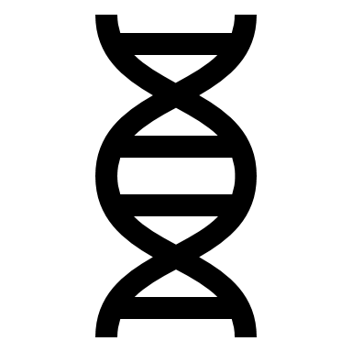

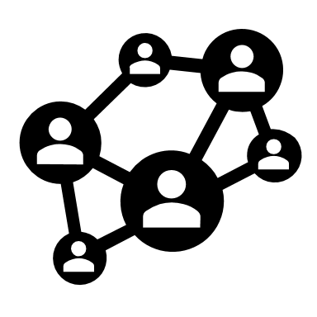


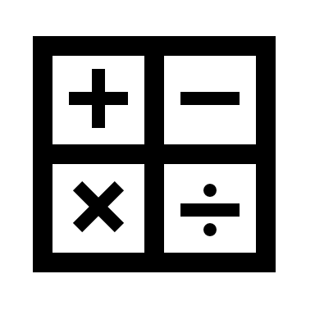
Proximal outcomes
(Diewald et al. 2015: 384-385)
„The only characteristics directly influenced by genes are those that lie ‘underneath the skin’.” (p. 384)
“The moderate effect of skills on the link between genes and attainment may also be due to the fact that concepts like IQ,[…], and health are less proximal to genes.” (p.384)
?

Slide 20
References
Diewald, M., Baier, T., Schulz, W., & Schunck, R. (2015). Status attainment and social mobility. Kölner Zeitschrift für Soziologie und Sozialpsychologie, 67(Suppl. 1), 371–395. https://doi.org/10.1007/s11577-015-0317-6
Freese, J., & Shostak, S. (2009). Genetics and Social Inquiry. Annual Review of Sociology, 35(1), 107–128. https://doi.org/10.1146/annurev-soc-070308-120040
Guo, G., & Stearns, E. (2002). The social influences on the realization of genetic potential for intellectual development. Social Forces, 80(3), 881–910. https://doi.org/10.1353/sof.2002.0007
Jaffee, S. R., & Price, T. S. (2007). Gene–environment correlations: a review of the evidence and implications for prevention of mental illness. Molecular Psychiatry, 12(5), 432–442. https://doi.org/10.1038/sj.mp.4001950
Knopik, V. S., Neiderhiser, J. M., DeFries, J. C., & Plomin, R. (2017). Behavioral genetics (7th Edition). Worth Publishers.

Slide 21
References
McGue, M., & Gottesman, I. I. (2015). Behavioral genetics. In The encyclopedia of clinical psychology (Vol. 1: A – Cli, pp. 341-351).
Neale, M. C., & Cardon, L. R. (2013). Methodology for genetic studies of twins and families. Springer Science & Business Media.
Turkheimer, E. (2000). Three laws of Behavior Genetics and what they mean. Current Directions in Psychological Science, 9(5), 160–164.
https://doi.org/10.1111/1467-8721.00084
Visscher, P. M., Hill, W. G., & Wray, N. R. (2008). Heritability in the genomics era — concepts and misconceptions. Nature Reviews Genetics, 9(4), 255–266. https://doi.org/10.1038/nrg2322

Slide 22
Session 1:
Working with TwinLife Data

Slide 23
Study Design - Background
TwinLife is a multi-disciplinary twin study, that enables to investigate the development of differences in life chances across individuals and groups as well as within and between families
Social inequalities = indicators that characterize the standing of individuals with respect to their capacity to consume or produce goods that are either generally valued in our society or by the individuals themselves
Different dimensions of social inequality:
  e.g., education, social status, health, well-being, political and social participation

Slide 24
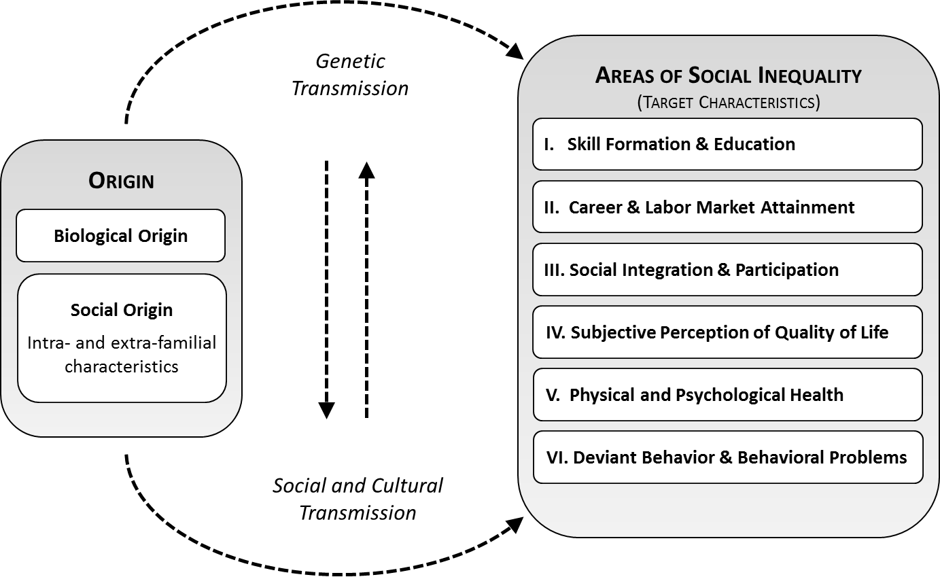
Basic concepts
To take a close look at the development of social inequalities, TwinLife examines different etiological factors as well as indicators of personal and social success and failure

Slide 25
Bringing together Sociology, Psychology & Behavioral Genetics
TwinLife takes a genetically informed life course perspective on social inequalities that acknowledges the importance of both genetic and social determinants:
  Genetic influences, psychological and social mechanisms, (social) contexts and their interaction and covariation
  Whole families as database for these processes
  Development in childhood, adolescence, and young adulthood in a prospective longitudinal design
  Combination of a multi-cohort cross-sequential and an extended twin family design

Slide 26
TwinLife terminology
Face-to-Face (F2F) | Household interview with a multi-method mixture of conventional and computer-based methods
CATI | Computer assisted telephone interview
Wave | A wave in TwinLife always consists of two data collections: a face-to-face interview and a telephone interview; both interview methods alternate in consecutive years per subsample
Subsample a/b | The overall sample is divided into two subsamples. The first data collection of subsample a started in 2014, subsample b participated one year later.
Cohort | TwinLife’s sample consists of 4 age cohorts of twins and their families: Cohort 1 – initial age 5, current age 13 Cohort 2 – initial age 11, current age 19 Cohort 3 – initial age 17, current age 25 Cohort 4 – initial age 23, current age 31
Cov | COVID supplementary questionnaires

Slide 27
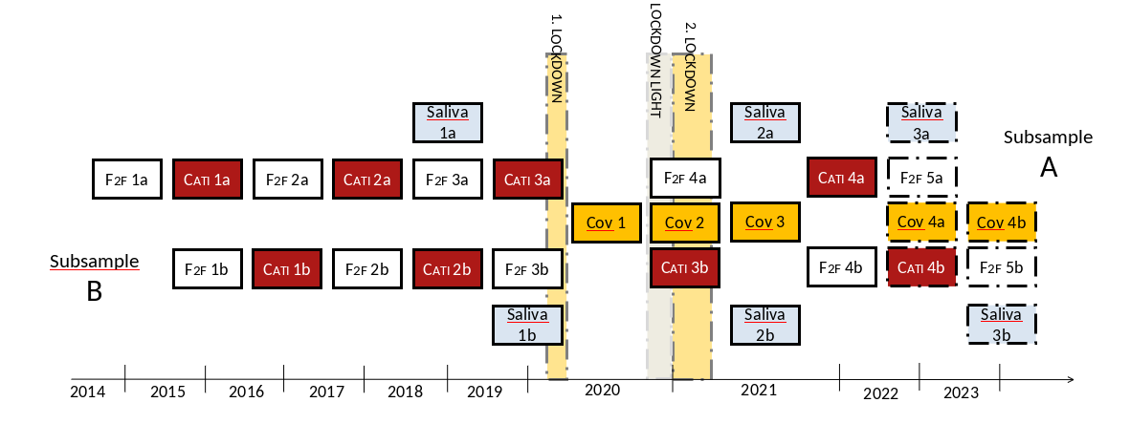
Design

Slide 28
Design
Cohort |  |  |  |  |  |  |  |  |  |  |  |  |  |  |  |  |  | Home
*born in |  |  |  |  |  |  |  |  |  |  |  |  |  |  |  | Tele
(age) |  |  |  |  |  |  |  |  |  |  |  |  |  | Home
 |  |  |  |  |  |  |  |  |  |  |  | Tele
 |  |  |  |  |  |  |  |  |  | Home
 |  |  |  |  |  |  |  | Tele |  |  |  |  |  |  |  |  |  | Home
Cohort 4 |  |  |  |  |  | Home |  |  |  |  |  |  |  |  |  | Tele
*1991/1992 |  |  |  | Tele |  |  |  |  |  |  |  |  |  | Home
(23 years) |  | Home |  |  |  |  |  |  |  |  |  | Tele
 |  |  |  |  |  |  |  |  |  | Home
 |  |  |  |  |  |  |  | Tele |  |  |  |  |  |  |  |  |  | Home
Cohort 3 |  |  |  |  |  | Home |  |  |  |  |  |  |  |  |  | Tele
*1997/1998 |  |  |  | Tele |  |  |  |  |  |  |  |  |  | Home
(17 years) |  | Home |  |  |  |  |  |  |  |  |  | Tele
 |  |  |  |  |  |  |  |  |  | Home
 |  |  |  |  |  |  |  | Tele |  |  |  |  |  |  |  |  |  | Home
Cohort 2 |  |  |  |  |  | Home |  |  |  |  |  |  |  |  |  | Tele
*2003/2004 |  |  |  | Tele |  |  |  |  |  |  |  |  |  | Home
(11 years) |  | Home |  |  |  |  |  |  |  |  |  | Tele
 |  |  |  |  |  |  |  |  |  | Home
 |  |  |  |  |  |  |  | Tele
Cohort 1 |  |  |  |  |  | Home
*2009/2010 |  |  |  | Tele
(5 years) |  | Home
 | 2014 |  | 2015 |  | 2016 |  | 2017 |  | 2018 |  | 2019 |  | 2020 |  | 2021 |  | 2022 |  | 2023
 |  |  |  |  |  |  |  |  |  |  |  |  | Year of measurement
4,000 twin families, over a time span of 9 years (2014 to 2023)
Cross-sequential survey design
Four birth cohorts capturing a total age range from 5 to 31 years and undergoing important life events
  1,000 twin pairs per cohort
Face-to-face interviews within the household every other year
Telephone interviews in the consecutive year
Only same-sex twins
Entry labor market
End school / Apprenticeship
End school / Apprenticeship
Secondary school
School enrollment

Slide 29
Extended twin family design
Step-
father
Mother
Father
Step-mother
Partner
Twin 1
Sibling
Twin 2
Partner
The cross-sequential structure is combined with an Extended Twin Family Design (ETFD)
  ETFD capturing the MZ or DZ same-sex twins and their biological family (biological parents and one sibling, if available), but also the complete environment the twins grow up in, if applicable including step-family members and twins’ spouses

Slide 30
TwinLife – A summary
A substantial number of participants, reflecting genetic and environmental variation in the population.
Longitudinal design capturing different developmental periods
Extended twin family design in which twins and parents are followed even after leaving the initial household, thus taking into account separated and step families as environment for individual development.
Continuous extensive measurement of the families’ environment.

Slide 31
Getting Started https://www.twin-life.de/documentation/downloads
Shortguide
  Easy and short introduction to the TwinLife study, provides an overview and guide on the various existing documentation texts
Longitudinal overview
  Quick overview of constructs including information on when these constructs were assessed and to which respondent person types (Caution: It is very simplified, so sometimes, the table can be misleading. Always check the item-level documentation and the data when considering longitudinal analyses.)
Scales manual
  Documentation of scientific scales that were adapted for the use in TwinLife with recoding and scale building guidance and additional information (Caution: It covers only a narrow range of constructs, do not neglect other items that are not covered by the scales manual. Always have a look at the item-level documentation as well.)

Slide 32
Item Documentation https://www.twin-life.de/documentation/downloads
Paneldata.org
  Twinlife provides documentations on item-level on paneldata.org, you can search for specific items with keywords and you can even see basic frequencies for the items as a graphic
Codebooks
  Basically the same information as on paneldata.org, but in a pdf-format

Slide 33
Item Documentation https://www.twin-life.de/documentation/downloads
Let‘s take a look at the documentation documents!
TwinLife Homepage
Documentation website
Shortguide
Scales manual
Paneldata
Codebook

Slide 34
Data structure: SUF
Data on the first two waves and the third face-to-face interview (F2F1, CATI1, F2F2, CATI2, F2F3) and two COVID supplementary questionnaire (Cov1, Cov2) is available
  1 „master“ dataset (basic information that will not change in the future: IDs, migration history, etc.)
  5 + 2 data sets in “individual format” (“long”)
    1 row per person
    All survey data incl. information on household & family structure
    (gross household composition incl. non-participating household members)
    Information on participation in the survey overall and
    the single questionnaires / modules in particular
    Wid1 = F2F1, wid2 = CATI1, wid3 = F2F2, wid4=CATI2; wid5= F2F3; cov1 = first COVID supplementary questionnaire, cov2 = second COVID supplementary questionnaire
  3 unadjusted datasets for the face-to-face data collections
  5 data sets in “family format” (“wide”)
    1 row per family
    Information of each participating person in the family stored
    in separate variables / columns
  1 data set containing zygosity questionnaire information
  1 mode data set containing the survey mode of each variable for each person

Slide 35
Data structure: person codes
Person codes
  numbers in variable ‘ptyp’ and final letters in variable names
    e.g. ‘sre0200t’ for the variable ‘sibling relationship’ concerning twin 1
Code | Person | ptyp
t | Twin 1 | 1
u | Twin 2 | 2
s | Surveyed sibling full or half; details see variable fpr0107 | 200
p | Partner of twin 1 | 110
q | Partner of twin 2 | 120
m | Mother of twins biological, adoptive & foster; details see variable fpr0107 | 300
n | Partner of twins’ father/ “stepmother” | 600
f | Father of twins biological, adoptive & foster; details see variable fpr0107 | 400
g | Partner of twins‘ mother/“stepfather“ | 500

Slide 36
Data structure: variable names
Example
1) „Individual“ format („long“ dataset)
⬇
pas0100m
2) „Family“ format („wide“ dataset)
⬇
pas0100m_s1

Slide 37
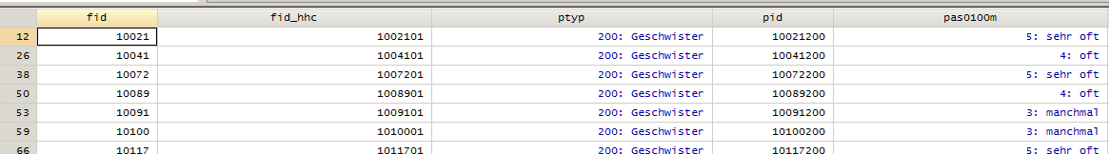
Data structure: variable names
Example 1)
  What information is in the variable name “pas0100m” in the “individual format” (“long” dataset)?
pas
variable stem: parental style – child report

Slide 38
Data structure: variable names
Example 1)
  What information is in the variable name “pas0100m” in the “individual format” (“long” dataset)?
pas01
item block: parental style

Slide 39
Data structure: variable names
Example 1)
  What information is in the variable name “pas0100m” in the “individual format” (“long” dataset)?
pas0100
item number: shows affection

Slide 40
Data structure: variable names
Example 1)
  What information is in the variable name “pas0100m” in the “individual format” (“long” dataset)?
pas0100m
person code: statement about mother

Slide 41
Data structure: variable names
Example 1)
  What information is in the variable name “pas0100m” in the “individual format” (“long” dataset)?
pas0100m
Item assessing the child’s rating of parental style, more precisely on how much affection the parent, here the mother, shows

