Slide 1




Behavioral Genetic Data Analysis Gene-by-Environment Interplay
September 22nd and 23rd, 2022
Lecturers: Dr. Bastian Mönkediek¹, Mirko Ruks¹, Christoph Klatzka², Theresa Rohm³ ¹ Bielefeld University, Bielefeld, Germany ² Saarland University, Saarbruecken, Germany ³ Bremen University, Bremen, Germany

Slide 2
Content
Introduction: Relevance of environments
Gene-Environment Correlation (rGE)
Example rGE
Gene-Environment Interaction (GxE)
Example GxE
Variance Components Models for GxE
UMX: Implementation of Purcell Model

Slide 3
1. Introduction
“At birth, each child has a genetic potential for intellectual development; but their chances for attaining, or achieving, their potential are conditioned by environmental factors.”
(Guo & Stearns 2002)

Slide 4
1. Introduction
Classical twin design (CTD) assumes no gene-environment interplay
However, the classical twin design “is only one empirical tool in a larger toolbox” (Verhulst & Hatemi 2013: 368-369)
Gene-environment interplay can be analyzed groupwise (no explicit test!) or with advanced models (e.g. Purcell Model)

Slide 5
1. Introduction: Biased genetic effects?
Biased genetic effects by GE interplay? (see Verhulst & Hatemi, 2013: 383)
Critique: the effect of GE interplay would increase the genetic component in the classical twin design
  unmodeled rAC: increases estimates of A if the correlation is negative
  unmodeled rAE: increases estimates of A if the correlation is positive
  AxC: increases estimates of A
  AxE: decrease estimates of A
→ Impact is dependent on the specific form of the relationship and the magnitude of the specific GE interplay

Slide 6
1. Introduction: Two forms
Two forms of gene-environment interplay:
Gene-Environment Correlation (rGE)
“G–E correlation (rGE) represents genetic control of exposure to different environments.”
Gene-Environment Interaction (GxE)
“G × E is often conceptualized as genetic control of sensitivity to different environments.”
(see Purcell 2002)

Slide 7
2. Gene-Environment Correlation (rGE)
A gene–environment correlation occurs when individual exposure to an environmental context depends on the genotype and vice versa (Jaffee and Price 2007 )
Three types of rGE
Active rGE: self-selection process in which individuals actively seek contexts or niches that match their genetically transmitted interests; e.g., individual’s genotype motivates him or her to select into/out of environments that influence the trait
Passive rGE: occurs when social environments appear according to inherited characteristics; e.g., people are often genetically related to individuals in their environments
Evocative rGE: situations in which genetically transmitted characteristics provoke specific reactions from the environment; e.g., individual evokes particular responses from the people who constitute their environment
→ Assumed type of rGE or GxE has implications for the data necessary to test for such interplay

Slide 8
3. Example rGE
Phenotype-environment correlations in longitudinal twin models
Example described by Beam and Turkheimer (2013): increases in cognitive ability over generational time (see also Dickens and Flynn, 2001)
  Small changes in phenotype can lead to subsequent reallocation of environmental resources
  Reciprocal feedback loop between phenotype and environment leading to accumulating gene-environment correlation (rGE)
Phenotype
Environment
Notes:
Dickens and Flynn (2001): high heritability of individual differences in IQ; massive environmental effects would be required to produce 0.5 SD increas of IC within one generation. But: reciprocal effects model: changes produced by small initial differences in phenotype could lead to subsequent changes in the environment and in turn to large changes in phenotpye.

Slide 9
3. Example rGE
What types or rGE are taking place in the example of increases in cognitive ability over generational time?
  Active rGE: tendency for individuals to select into more favorable environments, here: given their ability level
  Evocative rGE: reciprocal effect of the environment on individuals‘ ability
  Over time, this leads to large phenotypic differences, even
  if substantial cross-sectional genetic effects are present
Notes:
- Dickens and Flynn (2001): high heritability of individual differences in IQ; massive environmental effects would be required to produce 0.5 SD increas of IC within one generation. But: reciprocal effects model: changes produced by small initial differences in phenotype could lead to subsequent changes in the environment and in turn to large changes in phenotpye.

Slide 10
3. Example rGE
Small differences in phenotype of DZ twins or sibilings can become associated with reallocations of environmental resources within families
Gene-environment correlation (rGE) can be specified as a developmental process
  Causal relations between events over time
  Reciprocal causal effects betwen individuals‘ phenotypes and their environments over time
  Gene-environment matching process contributes to persistent twin or sibling differences over the course of the life span
Phenotype
Environment

Slide 11
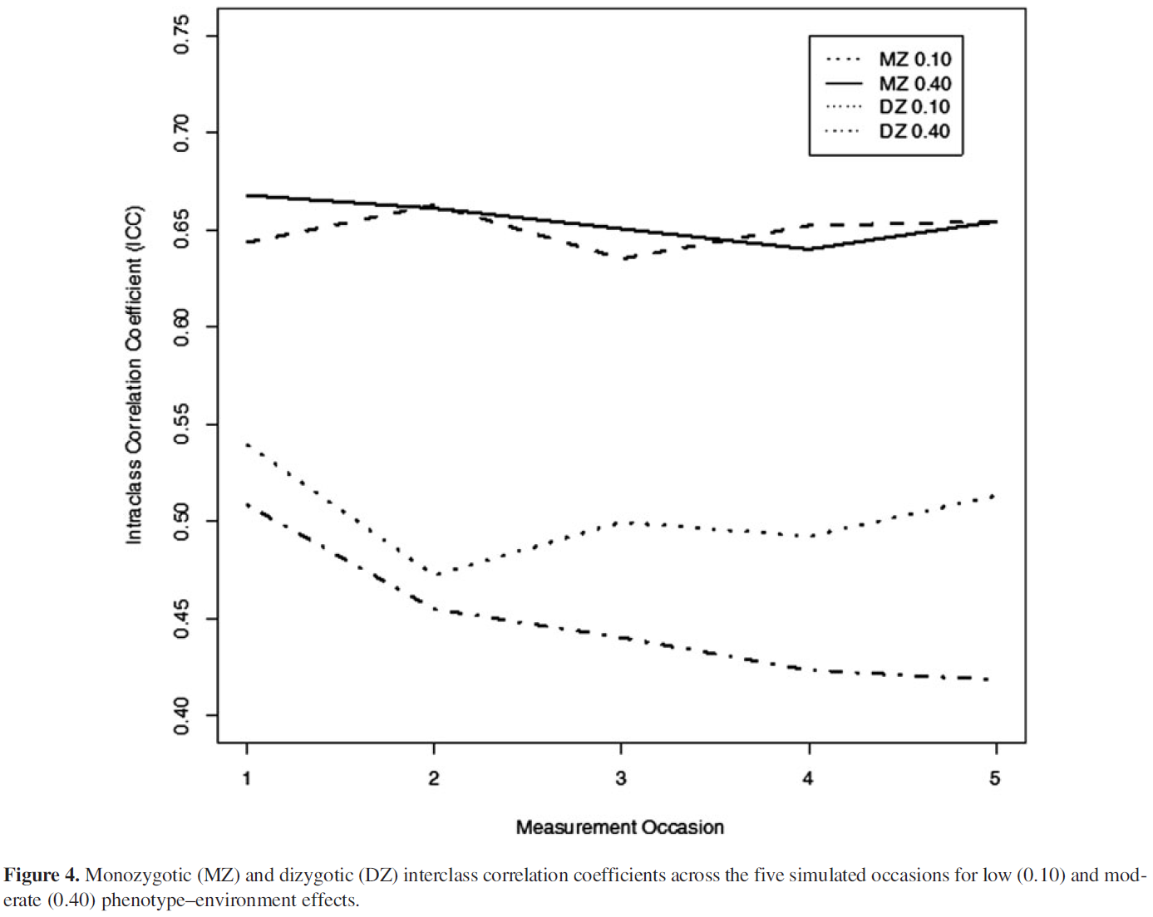
3. Example rGE
Beam and Turkheimer (2013) use model simulations to investigate the effect of unmodeled rGE
Phenotypic within-pair differentiation over time
  Here presented in terms of intra class correlations (ICC)
Notes:
- Beam and Turkheimer use model simulations to investigate the effect of unmodeled rGE

Slide 12
3. Example rGE
Phenotypic within-pair differentiation over time: effect of unmodeled rGE
  MZ ICCs remain constant over time
  DZ ICCs decrease over time
Notes:
- Dickens and Flynn (2001): high heritability of individual differences in IQ; massive environmental effects would be required to produce 0.5 SD increas of IC within one generation. But: reciprocal effects model: changes produced by small initial differences in phenotype could lead to subsequent changes in the environment and in turn to large changes in phenotpye.

Slide 13
3. Example rGE
Phenotypic within-pair differentiation over time: effect of unmodeled rGE
  MZ ICCs remain constant over time
Observed increase in genetic variance over time might actually be due to misspecified genetic variances
  DZ ICCs decrease over time
Potential to produce misleading findings in longitudinal beha-vioural genetics!
Notes:
- Dickens and Flynn (2001): high heritability of individual differences in IQ; massive environmental effects would be required to produce 0.5 SD increas of IC within one generation. But: reciprocal effects model: changes produced by small initial differences in phenotype could lead to subsequent changes in the environment and in turn to large changes in phenotpye.

Slide 14
3. Example rGE
Problem discussed by Beam and Turkheimer (2013) is the choice of longitudinal model (e.g., simplex, autoregressive, growth models)
  All fit the longitudinal data equally well and represent the structure of longitudinal data in different ways
  But different longitudinal models are not nested: difficulty in model comparison, especially when comparing utility of models to recover observed correlations among behavior over time
  Models including rGE cannot be compared statistically to
  models ignoring rGE
Notes:
- Dickens and Flynn (2001): high heritability of individual differences in IQ; massive environmental effects would be required to produce 0.5 SD increas of IC within one generation. But: reciprocal effects model: changes produced by small initial differences in phenotype could lead to subsequent changes in the environment and in turn to large changes in phenotpye.

Slide 15
4. Gene-Environment Interaction (GxE)
Genetic effects can for example vary across social groups
Gene-environment interaction is a processes by which genes alter an individuals’ actions towards specific features of the environment (Shanahan and Hofer, 2005)
Four ideal types of G × E Interactions:
  Triggering
  Compensation
  Social control
  Enhancement

Slide 16
4. Gene-Environment Interaction (GxE)
Triggering: Person has a genetic vulnerability that is expressed only in specific social contexts
Compensation: Social context is enriched and positively impacts individual functioning, e.g. hindering the expression of a genetic risk
Environment serves as a mode of social control: Refers to (institutionalized) belief systems (i.e., norms) that are embedded in the social context. Individual behavior is restricted by the inherent rules of the system. Prevent the realization of a genetic predisposition.
Enhancement: A social context that increases the genetic predisposition towards socially valued or accepted characteristics or behaviors. Refers to processes and interactions which increase positive functioning. The effect of genetic predisposition is accentuate.
(see Diewald et al., 2015: 380)

Slide 17

5. Example: Separate Analysis
Are there differences between groups?
GROUP A:
A: 40%
C: 30%
E: 30%
Fictive example
GROUP B:
A: 20%
C: 60%
E: 20%

Slide 18
5. Example: Separate Analysis
Are there differences in cognitive ability between groups with different parent education levels?
Study of Baier (2019): Does sibling and twin similarity in cognitive ability differ by parents' education?
Differences among children from the same family
Investigation of sibling similarity in cognitive ability and examination if similarity varies by parents’ education
Assumption that disadvantaged parents reinforce differences while advantaged parents compensate for differences vs. assumption that parents make equal investments
Hypothesis: advantaged parents foster children’s talents more individually, compared to disadvantaged parents and therefore sibling similarity is lower in advantaged than in disadvantaged families
Use of TwinLife cohorts 3 and 4

Slide 19
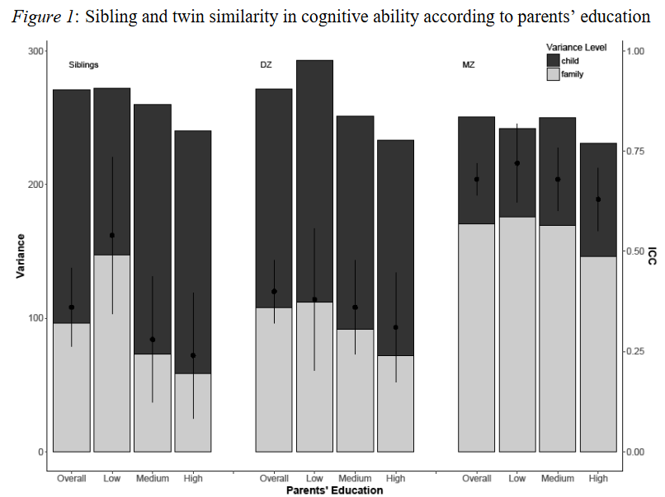
5. Example: Separate Analysis
Study of Baier (2019): Does sibling and twin similarity in cognitive ability differ by parents' education?
Finding: Cognitive ability scores are more different in more highly educated families than in less educated families!
Notes:
Siblings appear to be more similar in disadvantaged families, compared with siblings from advantaged families.
Hypothesis: parents make equal investments and adopt different parenting concept

Slide 20
5. Example: Separate Analysis
Study of Baier (2019): Does sibling and twin similarity in cognitive ability differ by parents' education?
Based on twin correlations of different samples (!)
Notes:
Siblings appear to be more similar in disadvantaged families, compared with siblings from advantaged families.
Hypothesis: parents make equal investments and adopt different parenting concept

Slide 21
5. Example: Separate Analysis
Are there differences between groups?
Advantages:
Easy to implement
Easy to interpret?
Disadvantages:
No statistical test is performed
Cannot differentiate between rGE and GxE

Slide 22



5. Example GxE
Are there differences between groups?
Etiology of reading

Slide 23
5. Example GxE
Study of Taylor et al. (2010): Teacher Quality Moderates the Genetic Effects on Early Reading
Children’s reading achievement is assumed to be influenced by genetics, as well as by family and school environments
Teacher quality was investigated as a specific school environmental influence on reading achievement
Teacher quality was measured by how much reading gain the non-twin classmates achieved
Sample consisted of first- and second-grade students; 280 MZ (143 female; 137 male) and 526 DZ (130 same-sex female; 128 same-sex male; 268 opposite-sex) twin pairs from Florida Twin Project on Reading

Slide 24
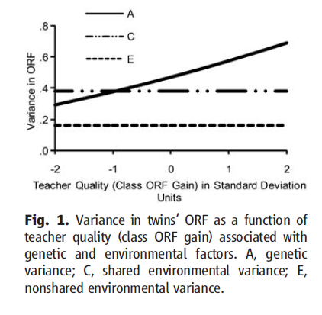
5. Example GxE
Finding: Poor teaching impedes the ability of children to reach their potential!
Teacher quality as moderating environmental factor of student early Oral Reading Fluency (ORF) in study of Taylor et al. (2010)

Slide 25
6. Variance Components Models for GxE
Simple quantitative genetic models average over any group differences within a population, but a single statistic might not be adequate to describe a whole population (Purcell 2002)
  Because genetic effects might depend on individuals’ environments
  For example, for half the population (e.g., males) a trait is completely genetically determined, whereas for the other half (e.g., females) a trait is completely environmentally determined
A solution can be the use of variance components models for gene–environment interaction (Purcell 2002)
  The univariate case
  The full bivariate case

Slide 26
6. Variance Components Models for GxE
The Purcell Modell (Purcell, 2002: 557)
Incorporating moderation effects
Partitioning of genetic effects into:
a mean part (which is independent of the environment) and
a part that is a linear function of the environment

Slide 27
6. Variance Components Models for GxE
The Purcell Modell (Purcell, 2002: 556)

Slide 28
6. Variance Components Models for GxE
Full bivariate case (see Van der Sluis et al., 2012)
Moderating factor may itself be correlated with the trait under study
  covariance between trait under study and the moderator might depend on the level of the moderator
  can lead to an inflation of false positive results
Problem occurs only if moderators are unequal for both twins
  family-level moderators, or when moderators show no variation at the twin pair level: false positive results rather too low than too high

Slide 29
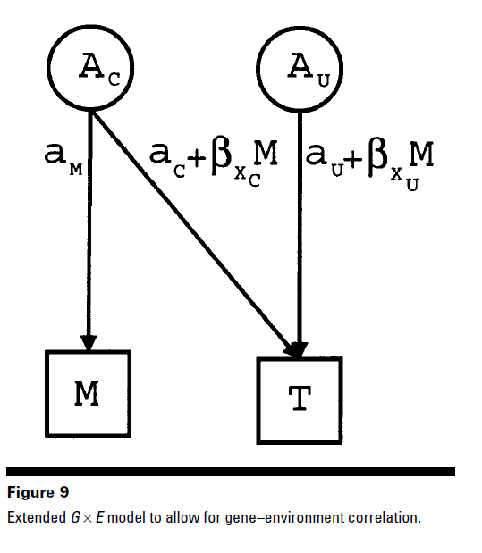
6. Variance Components Models for GxE
Extended Model
(Purcell 2002: 565)
Use it when moderator varies across twins!
Otherwise use the univariate model, but also test bivariate model before running the univariate case

Slide 30
6. Variance Components Models for GxE
Ordinal and binary outcome data in Purcell‘s G x E model (see Medland et al., 2009)
Outcome/ dependent variable might be ordinal or binary data
  Usually, models therefore require constraining total variance to unity to ensure identification (e.g., liability threshold model)
  In continuous case of the Purcell model (2002), unstandardized results are reported to obtain information regarding the source of changes in variance
  Standardizing the solution provides information only on relative values of the genetic and environmental variance components for a given value of the moderator
Solution presented by Medland et al. (2009)
  Ordinal data: values of the first two thresholds are fixed and total variance changes as function of moderator
  Binary data: constraining total variance to unity for a given value of the moderator is sufficient

Slide 31
7. UMX: Implementation of Purcell Model
Univariate model
GE = umxGxE(selDVs= “VAR", selDefs= “VAR", sep= "", mzData = mz, dzData = dz, tryHard= "yes", dropMissingDef = TRUE, dzAr = 0.5)
Dependent variable
Moderator
Run umxReduce(GE) to test which model fits the data best!
See also Bates, Maes and Neale (2019)

Slide 32
7. UMX: Implementation of Purcell Model
Full bivariate model
GEbiv = umxGxEbiv(selDVs= “VAR", selDefs= “VAR", sep= "", mzData = mz, dzData = dz, tryHard= "yes", dropMissingDef = TRUE, dzAr = 0.5)
Dependent variable
Moderator
Need to modify path per hand (umxModify) to compare models!
See also Bates, Maes and Neale (2019)

Slide 33
References
Baier, T. (2019). Does sibling and twin similarity in cognitive ability differ by parents’ education? Journal of Family Research, 31(1), 58–82. https://doi.org/10.3224/zff.v31i1.04
Bates, T. C., Maes, H., & Neale, M. C. (2019). umx: Twin and path-based structural equation modeling in R. Twin Research and Human Genetics, 22(1), 27-41. https://doi.org/10.1017/thg.2019.2Jaffee and Price 2007
Beam, C. R., & Turkheimer, E. (2013). Phenotype–environment correlations in longitudinal twin models. Development and Psychopathology, 25(1), 7–16. https://doi.org/10.1017/s0954579412000867
Dickens, W. T., & Flynn, J. R. (2001). Heritability estimates versus large environmental effects: The IQ paradox resolved. Psychological Review, 108(2), 346–369. https://doi.org/10.1037/0033-295x.108.2.346
Diewald, M., Baier, T., Schulz, W., & Schunck, R. (2015). Status attainment and social mobility. Kölner Zeitschrift für Soziologie und Sozialpsychologie, 67(Suppl. 1), 371–395. https://doi.org/10.1007/s11577-015-0317-6
Guo, G., & Stearns, E. (2002). The social influences on the realization of genetic potential for intellectual development. Social Forces, 80(3), 881–910. https://doi.org/10.1353/sof.2002.0007
Medland, S. E., Neale, M. C., Eaves, L. J., & Neale, B. M. (2009). A note on the parameterization of Purcell’s G × E model for ordinal and binary data. Behavior Genetics, 39(2), 220–229. https://doi.org/10.1007/s10519-008-9247-7

Slide 34
References
Purcell, S. (2002). Variance Components Models for Gene–Environment Interaction in twin analysis. Twin Research, 5(6), 554–571. https://doi.org/10.1375/136905202762342026
Shanahan, M. J., & Hofer, S. M. (2005). Social Context in Gene–Environment Interactions: Retrospect and prospect. The Journals of Gerontology: Series B, 60(Special_Issue_1), 65–76. https://doi.org/10.1093/geronb/60.special_issue_1.65
Taylor, J., Roehrig, A. D., Hensler, B. S., Connor, C. M., & Schatschneider, C. (2010). Teacher quality moderates the genetic effects on early reading. Science, 328(5977), 512–514. https://doi.org/10.1126/science.1186149
Van Der Sluis, S., Posthuma, D., & Dolan, C. V. (2012). A note on false positives and power in G × e modelling of twin data. Behavior Genetics, 42(1), 170–186. https://doi.org/10.1007/s10519-011-9480-3
Verhulst, B., & Hatemi, P. K. (2013). Gene-Environment interplay in twin models. Political Analysis, 21(3), 368–389. https://doi.org/10.1093/pan/mpt005

