Slide 1




Behavioral Genetic Data Analysis The ACE-beta model
September 22nd and 23rd, 2022
Lecturers: Dr. Bastian Mönkediek¹, Mirko Ruks¹, Christoph Klatzka², Theresa Rohm³ ¹ Bielefeld University, Bielefeld, Germany ² Saarland University, Saarbruecken, Germany ³ Bremen University, Bremen, Germany

Slide 2
Idea of ACE-beta model
Combine two different approaches
  Economic approach of identifying causal effects by estimating twin-fixed effects models
  Behavioral genetic approach of decomposing the (co-)variances in genetic and environmental influences

Slide 3
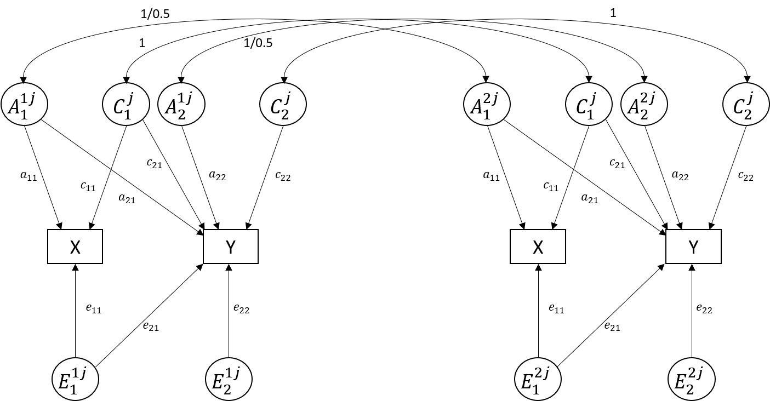
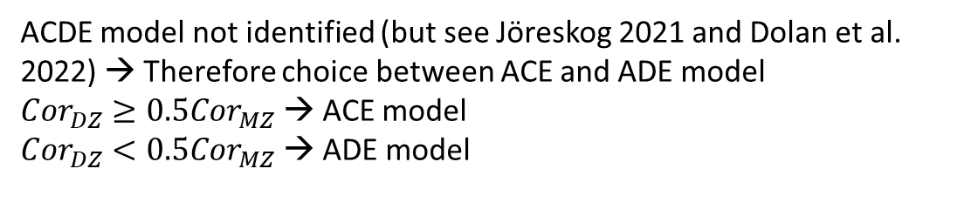
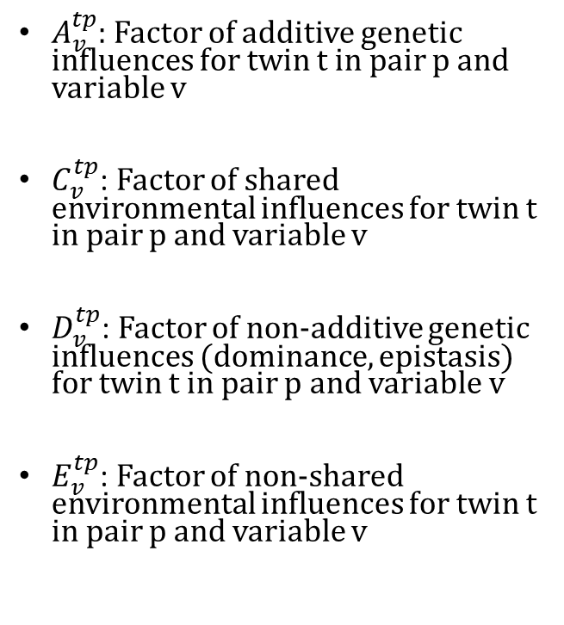
Bivariate ACE model
$A_{v}^{tp}$: Factor of additive genetic influences for twin t in pair p and variable v
$C_{v}^{tp}$: Factor of shared environmental influences for twin t in pair p and variable v
$D_{v}^{tp}$: Factor of non-additive genetic influences (dominance, epistasis) for twin t in pair p and variable v
$E_{v}^{tp}$: Factor of non-shared environmental influences for twin t in pair p and variable v
ACDE model not identified (but see Jöreskog 2021 and Dolan et al. 2022) → Therefore choice between ACE and ADE model
${Cor}_{DZ}≥0.5{Cor}_{MZ}$ → ACE model
${Cor}_{DZ}<0.5{Cor}_{MZ}$ → ADE model

Slide 4
























Bivariate ACE model
1/0.5
1
1
1/0.5
$$A_{1}^{1j}$$
$$C_{1}^{j}$$
$$A_{2}^{1j}$$
$$C_{2}^{j}$$
$$A_{1}^{2j}$$
$$C_{1}^{j}$$
$$A_{2}^{2j}$$
$$C_{2}^{j}$$
$$c_{21}$$
$$a_{22}$$
$$c_{21}$$
$$a_{22}$$
$$a_{11}$$
$$c_{11}$$
$$c_{22}$$
$$a_{11}$$
$$c_{11}$$
$$c_{22}$$
$$a_{21}$$
$$a_{21}$$
X
Y
X
Y
$$e_{11}$$
$$e_{22}$$
$$e_{11}$$
$$e_{22}$$
$$e_{21}$$
$$e_{21}$$
$$E_{1}^{1j}$$
$$E_{2}^{1j}$$
$$E_{1}^{2j}$$
$$E_{2}^{2j}$$

Slide 5
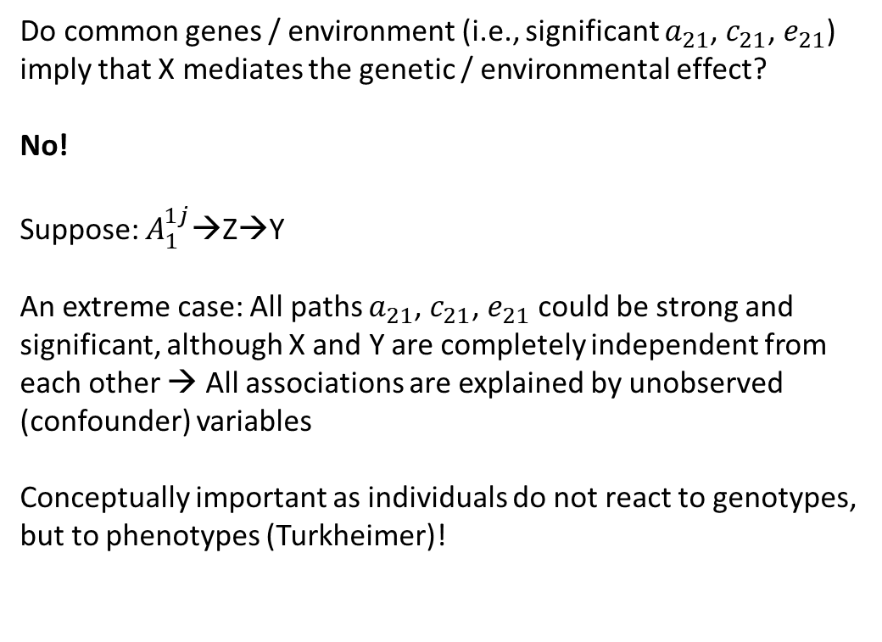
Bivariate ACE model
Do common genes / environment (i.e., significant $a_{21}$, $c_{21}$, $e_{21}$) imply that X mediates the genetic / environmental effect?
No!
Suppose: $A_{1}^{1j}$→Z→Y
An extreme case: All paths $a_{21}$, $c_{21}$, $e_{21}$ could be strong and significant, although X and Y are completely independent from each other → All associations are explained by unobserved (confounder) variables
Conceptually important as individuals do not react to genotypes, but to phenotypes (Turkheimer)!
Modelling a phenotypic path would be nice for at least two reasons:
Causal inference
Theoretical mechanisms (e.g. rGE: Based on which genetically influenced traits individuals select into environments?)

Slide 6











Twin fixed effects model
Consider twin i in pair j. Effect of X on Y. Three sets of unobserved confounders:
1) Social endowments on the family level (C)
2) Genetic endowments (A)
3) Unique individual environmental influences (E)
$$A_{1}^{1j}$$
$$C_{1}^{j}$$
$$A_{2}^{1j}$$
$$C_{2}^{j}$$
„True Model“
$$c_{21}$$
$$a_{22}$$
$$a_{11}$$
$$c_{11}$$
$$c_{22}$$
$$a_{21}$$
X
$$β$$
Y
$$e_{11}$$
$$e_{22}$$
$$e_{21}$$
$$E_{1}^{1j}$$
$$E_{2}^{1j}$$

Slide 7
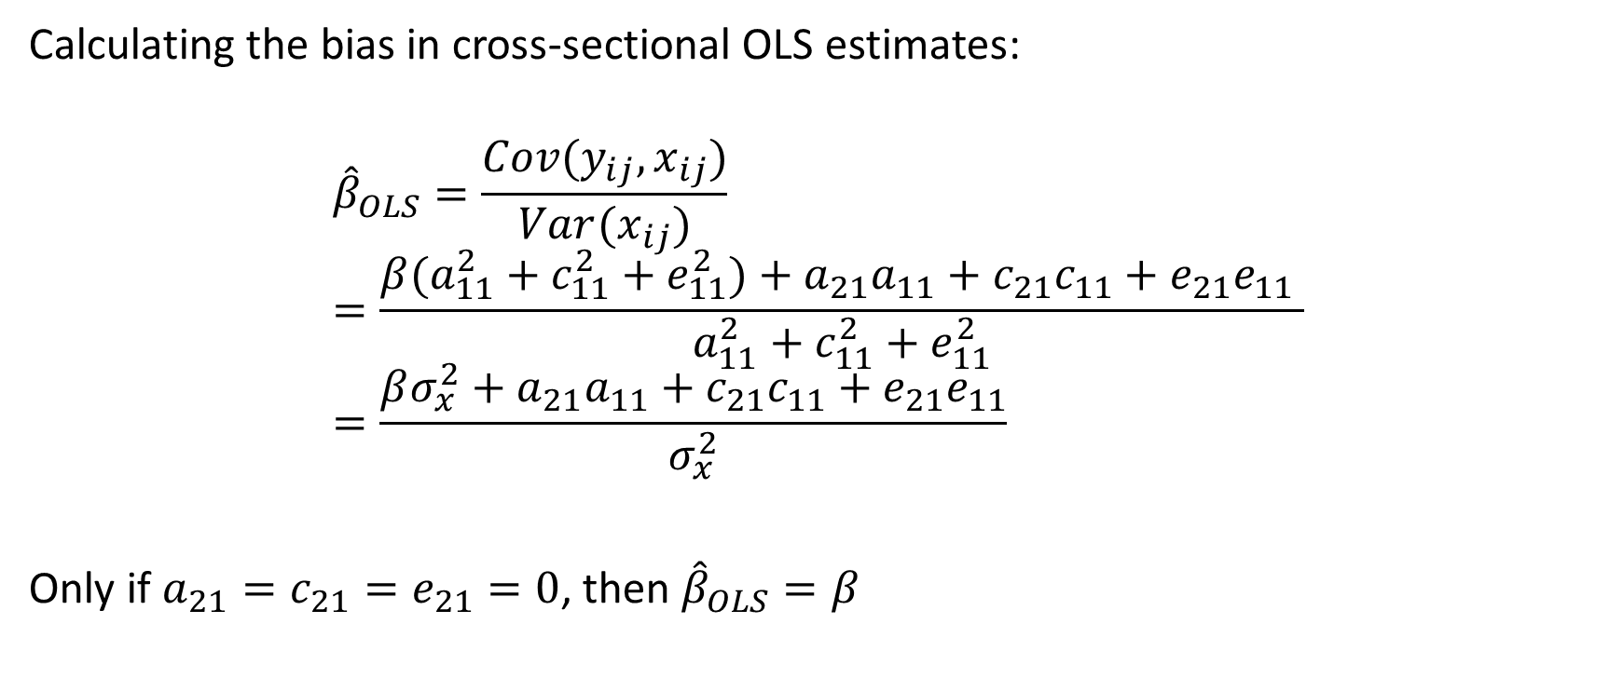
Twin-fixed effects model
Calculating the bias in cross-sectional OLS estimates:
$${\hat{β}}_{OLS}=\frac{Cov(y_{ij},x_{ij})}{Var(x_{ij})} \\ =\frac{β(a_{11}^{2}+c_{11}^{2}+e_{11}^{2})+a_{21}a_{11}+c_{21}c_{11}+e_{21}e_{11} }{a_{11}^{2}+c_{11}^{2}+e_{11}^{2}}=\frac{βσ_{x}^{2}+a_{21}a_{11}+c_{21}c_{11}+e_{21}e_{11}}{σ_{x}^{2}}$$
Only if $a_{21}=c_{21}=e_{21}=0$, then ${\hat{β}}_{OLS}=β$

Slide 8
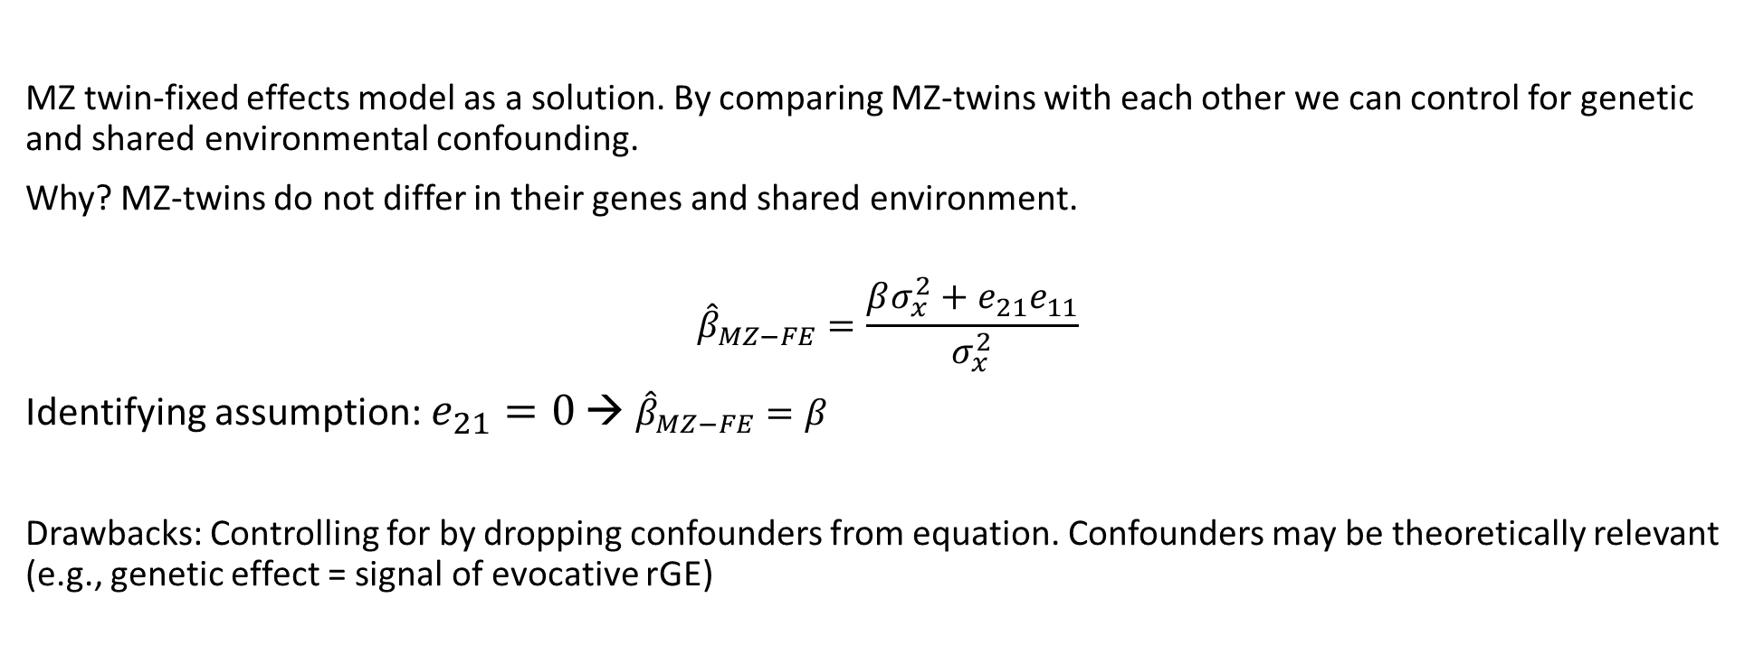
Twin-fixed effects model
MZ twin-fixed effects model as a solution. By comparing MZ-twins with each other we can control for genetic and shared environmental confounding.
Why? MZ-twins do not differ in their genes and shared environment.
$${\hat{β}}_{MZ−FE}=\frac{βσ_{x}^{2}+e_{21}e_{11}}{σ_{x}^{2}}$$
Identifying assumption: $e_{21}=0$ → ${\hat{β}}_{MZ−FE}=β$
Drawbacks: Controlling for by dropping confounders from equation. Confounders may be theoretically relevant (e.g., genetic effect = signal of evocative rGE)

Slide 9


ACE-beta model
1/0.5
1
1
1/0.5
$$A_{1}^{1j}$$
$$C_{1}^{j}$$
$$A_{2}^{1j}$$
$$C_{2}^{j}$$
$$A_{1}^{2j}$$
$$C_{1}^{2j}$$
$$A_{2}^{2j}$$
$$C_{2}^{j}$$
$$c_{21}$$
$$a_{22}$$
$$c_{21}$$
$$a_{22}$$
$$a_{11}$$
$$c_{11}$$
$$c_{22}$$
$$a_{11}$$
$$c_{11}$$
$$c_{22}$$
$$a_{21}$$
$$a_{21}$$
X
$$β$$
Y
X
$$β$$
Y
$$e_{11}$$
$$e_{22}$$
$$e_{11}$$
$$e_{22}$$
$$E_{1}^{1j}$$
$$E_{2}^{1j}$$
$$E_{1}^{2j}$$
$$E_{2}^{2j}$$

Slide 10
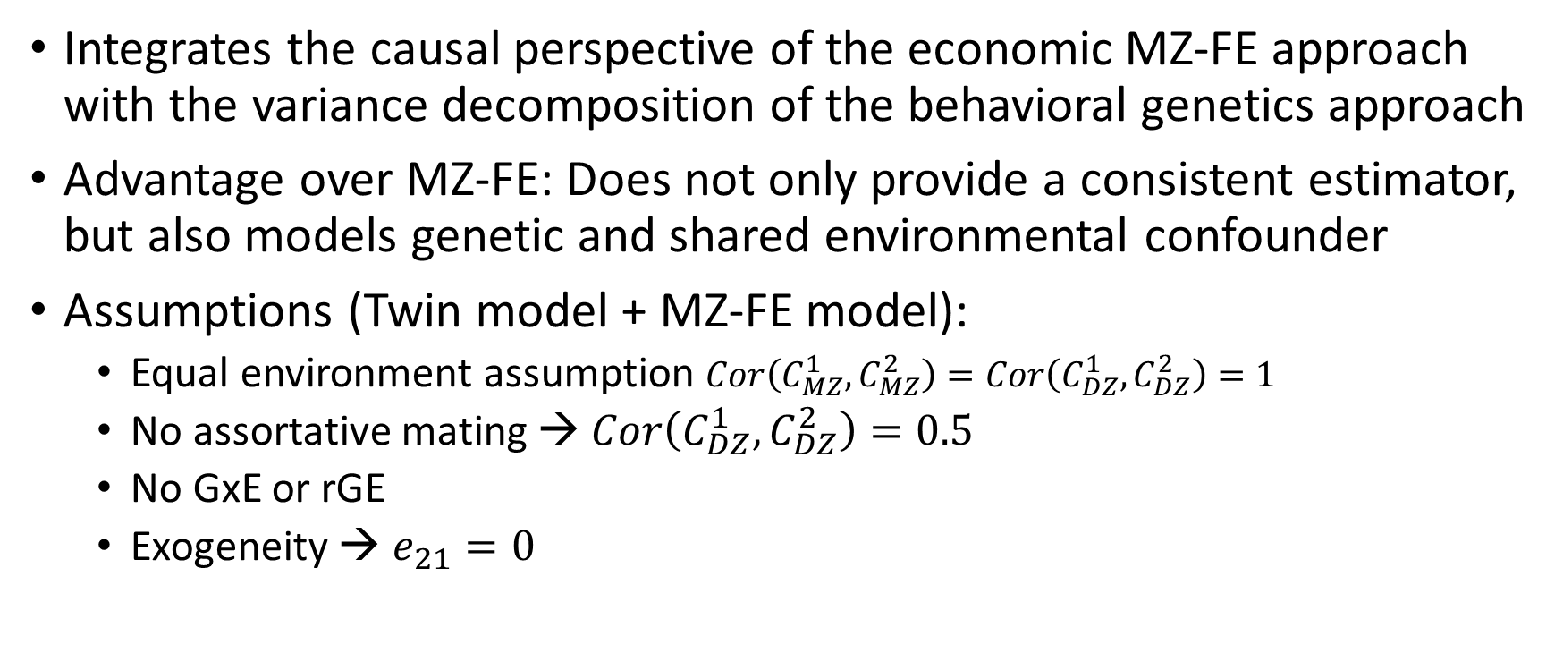
ACE-beta model
Integrates the causal perspective of the economic MZ-FE approach with the variance decomposition of the behavioral genetics approach
Advantage over MZ-FE: Does not only provide a consistent estimator, but also models genetic and shared environmental confounder
Assumptions (Twin model + MZ-FE model):
  Equal environment assumption $Cor\left(C_{MZ}^{1},C_{MZ}^{2}\right)=Cor\left(C_{DZ}^{1},C_{DZ}^{2}\right)=1$
  No assortative mating → $Cor\left(C_{DZ}^{1},C_{DZ}^{2}\right)=0.5$
  No GxE or rGE
  Exogeneity → $e_{21}=0$
Twin model
MZ-FE model

Slide 11
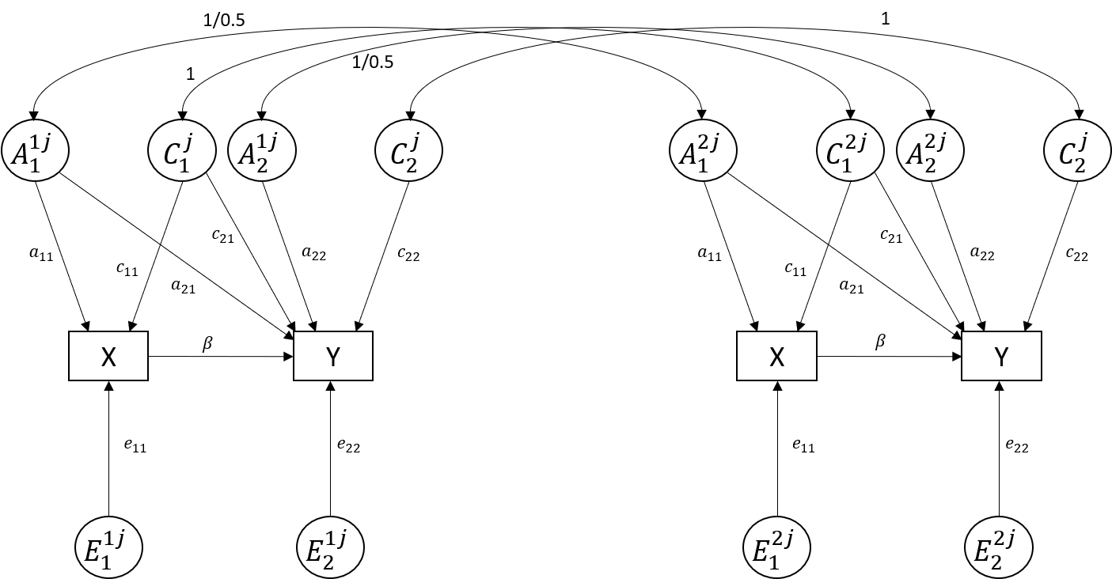
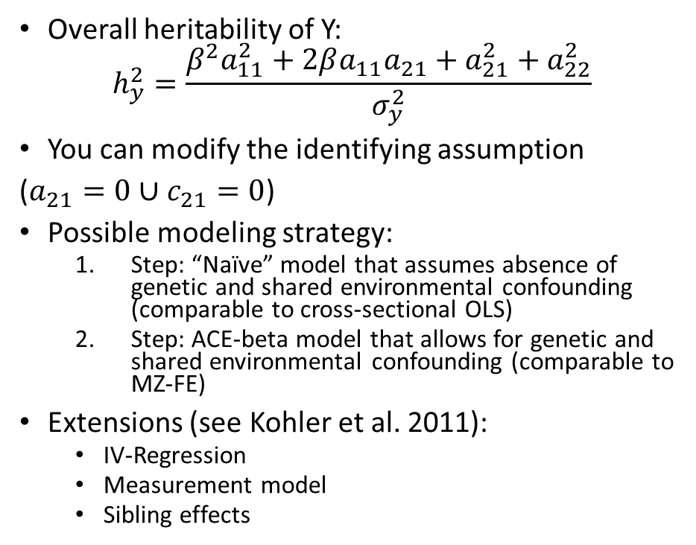
ACE-beta model
Overall heritability of Y:
$$h_{y}^{2}=\frac{β^{2}a_{11}^{2}+2βa_{11}a_{21}+a_{21}^{2}+a_{22}^{2}}{σ_{y}^{2}}$$
You can modify the identifying assumption
($a_{21}=0∪c_{21}=0$)
Possible modeling strategy:
  Step: “Naïve” model that assumes absence of genetic and shared environmental confounding (comparable to cross-sectional OLS)
  Step: ACE-beta model that allows for genetic and shared environmental confounding (comparable to MZ-FE)
Extensions (see Kohler et al. 2011):
  IV-Regression
  Measurement model
  Sibling effects
OpenMx

Slide 12
ACE-beta model in R
twinflex: aceb_model <- twinflex(acevars = c(„x“, „y“), sep = „_“, data = df, zyg = „zyg“, type = „aceb“, tryHard = TRUE)
OpenMx: not covered here
Make sure that it is correctly coded:
Name = „zyg“
1 = MZ; 2 = DZ
Always a good choice for more complex models

Slide 13
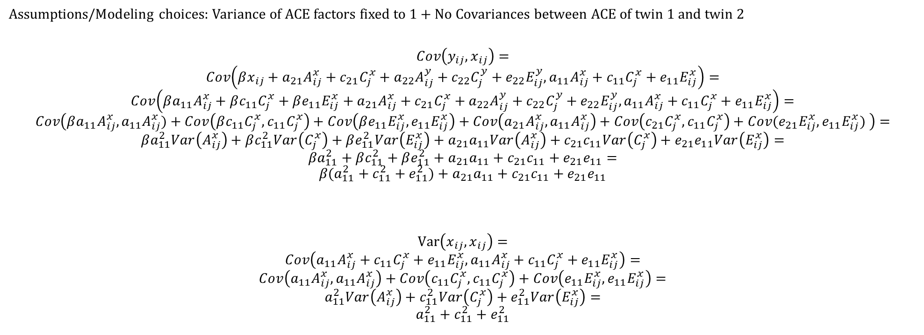
Derivation beta formula with covariance algebra
Assumptions/Modeling choices: Variance of ACE factors fixed to 1 + No Covariances between ACE of twin 1 and twin 2
$$Cov\left(y_{ij},x_{ij}\right)=$$
$$Cov\left(βx_{ij}+a_{21}A_{ij}^{x}+c_{21}C_{j}^{x}+a_{22}A_{ij}^{y}+c_{22}C_{j}^{y}+e_{22}E_{ij}^{y},a_{11}A_{ij}^{x}+c_{11}C_{j}^{x}+e_{11}E_{ij}^{x}\right)=$$
$$Cov\left(βa_{11}A_{ij}^{x}+βc_{11}C_{j}^{x}+βe_{11}E_{ij}^{x}+a_{21}A_{ij}^{x}+c_{21}C_{j}^{x}+a_{22}A_{ij}^{y}+c_{22}C_{j}^{y}+e_{22}E_{ij}^{y},a_{11}A_{ij}^{x}+c_{11}C_{j}^{x}+e_{11}E_{ij}^{x}\right)=$$
$$Cov\left(βa_{11}A_{ij}^{x},a_{11}A_{ij}^{x})+Cov\left(βc_{11}C_{j}^{x},c_{11}C_{j}^{x}\right)+Cov\left(βe_{11}E_{ij}^{x},e_{11}E_{ij}^{x}\right)+Cov\left(a_{21}A_{ij}^{x},a_{11}A_{ij}^{x}\right)+Cov\left(c_{21}C_{j}^{x},c_{11}C_{j}^{x}\right)+Cov(e_{21}E_{ij}^{x},e_{11}E_{ij}^{x}) \right)=$$
$$βa_{11}^{2}Var\left(A_{ij}^{x}\right)+βc_{11}^{2}Var\left(C_{j}^{x}\right)+βe_{11}^{2}Var\left(E_{ij}^{x}\right)+a_{21}a_{11}Var\left(A_{ij}^{x}\right)+c_{21}c_{11}Var\left(C_{j}^{x}\right)+e_{21}e_{11}Var\left(E_{ij}^{x}\right)=$$
$$βa_{11}^{2}+βc_{11}^{2}+βe_{11}^{2}+a_{21}a_{11}+c_{21}c_{11}+e_{21}e_{11}=$$
$$β(a_{11}^{2}+c_{11}^{2}+e_{11}^{2})+a_{21}a_{11}+c_{21}c_{11}+e_{21}e_{11}$$
$$Var\left(x_{ij},x_{ij}\right)=$$
$$Cov\left(a_{11}A_{ij}^{x}+c_{11}C_{j}^{x}+e_{11}E_{ij}^{x},a_{11}A_{ij}^{x}+c_{11}C_{j}^{x}+e_{11}E_{ij}^{x}\right)=$$
$$Cov\left(a_{11}A_{ij}^{x},a_{11}A_{ij}^{x}\right)+Cov\left(c_{11}C_{j}^{x},c_{11}C_{j}^{x}\right)+Cov\left(e_{11}E_{ij}^{x},e_{11}E_{ij}^{x}\right)=$$
$$a_{11}^{2}Var\left(A_{ij}^{x}\right)+c_{11}^{2}Var\left(C_{j}^{x}\right)+e_{11}^{2}Var\left(E_{ij}^{x}\right)=$$
$$a_{11}^{2}+c_{11}^{2}+e_{11}^{2}$$

Slide 14
Literature
Kohler, H.-P., Behrman, J. R., & Schnittker, J. (2011). Social Science Methods for Twins Data: Integrating Causality, Endowments, and Heritability. Biodemography and Social Biology, 57(1), 88–141. https://doi.org/10.1080/19485565.2011.580619
Turkheimer, E., & Harden, K. (2014). Behavior Genetic Research Methods: Testing Quasi-Causal Hypotheses Using Multivariate Twin Data. In H. Reis & C. Judd (Eds.), Handbook of Research Methods in Social and Personality Psychology (pp. 159-187). Cambridge University Press. https://doi.org/10.1017/cbo9780511996481.012
Jöreskog, K. G. (2021). Classical models for twin data. Structural Equation Modeling: A Multidisciplinary Journal, 28(1), 121-126. https://doi.org/10.1080/10705511.2020.1789465
Dolan, C. V., Boomsma, D. I., Nivard, M. G., & Neale, M. C. (2022). A note on Jöreskog’s ACDE twin model: a solution, not the solution. Structural Equation Modeling: A Multidisciplinary Journal, 29(6), 933–934. https://doi.org/10.1080/10705511.2022.2095640
Applications: e.g.:
Stienstra, K., Maas, I., Knigge, A., & Schulz, W. (2021). Resource Compensation or Multiplication? The Interplay between Cognitive Ability and Social Origin in Explaining Educational Attainment. European Sociological Review, 37(2), 186–200. https://doi.org/10.1093/esr/jcaa054
Kretschmer, T., Tropf, F. C., & Niezink, N. (2018). Causality and pleiotropy in the association between bullying victimization in adolescence and depressive episodes in adulthood. Twin Research and Human Genetics, 21(1), 33–41. https://doi.org/10.1017/thg.2017.71

