Slide 1




Behavioral Genetic Data Analysis Recap uni- and bivariate ACE models, ordinal outcomes
September 22nd and 23rd, 2022
Lecturers: Dr. Bastian Mönkediek¹, Mirko Ruks¹, Christoph Klatzka², Theresa Rohm³ ¹ Bielefeld University, Bielefeld, Germany ² Saarland University, Saarbruecken, Germany ³ Bremen University, Bremen, Germany

Slide 2








The TwinLife Team
Dr. Bastian Mönkediek
M.A. Theresa Rohm
M.Sc.-Psych. Christoph Klatzka
M.A. Mirko Ruks

Slide 3
Behavioral genetics
Behavioral genetics seeks to use the powerful tools of genetics – twin and adoption studies as well as molecular genetic investigations – to characterize the origins of individual differences in behavior. These origins can lie in the genetic makeup, the environment and/or the complex interplay between them. (McGue & Gottesman, 2015)

Slide 4
Why twin studies?
„Twinning is an experiment of nature that produces identical twins, who are genetically identical, and fraternal twins who are only 50 percent similar genetically. If genetic factors are important for a trait, identical twins must be more similar.“ (Knopik et al. 2017, p. 87)
→ Twins are the perfect population to study genetic and environmental effects.
Notes:
Buch Seite 87

Slide 5
Polygenic traits
There are some traits or characteristics that are monogenic, i.e. there is only one single gene involved (e.g. Huntington disease). A phenotype can be predicted by knowing the genotype. (Knopik et al. 2017)
However, most human traits are polygenic, i.e. a lot of different genes contribute to the expression of the phenotype (Knopik et al. 2017)
Notes:
https://

Slide 6
  Heritability (A)
  (Mönkediek 2021: 119)
The degree to which an outcome variable (trait) varies by genetic variation in a given population (Freese & Shostak 2009).
Narrow sense heritability (h²)
  additive genetic effects; the averaged effects of single alleles on the phenotype (Neale & Cardon 2013: 12).
  Broad sense heritability (H²)
  The sum of the additive genetic and non-additive genetic effects (Visscher, Hill, & Wray 2008: 256). Non-additive genetic effects relate mainly to dominance and epistasis.

Slide 7
Environmental effects
For twins (and siblings in general), environmental effects can be decomposed into two distinct environmental influences:
Shared environment (C)
  Degree of variation in a phenotypic trait in a population that is due to an environment that twins have in common, such as the family.
Unshared environment (E)
  Degree of variation in a phenotypic trait in a population that is due to an environment that is unique to each twin [includes the error term]
Notes:
The effect of the shared environment:
includes family characteristics (often measured)
but also those usually not measured:
infrastructural
cultural environments
neighborhoods.
→ for young children, the shared environment estimate
should closely approximate a total family effect.

Slide 8



Twin Correlations
The Classical Twin Design (CTD) compares the similarities in a trait across monozygotic (MZ) and dizygotic (DZ) twin pairs.
The interclass-correlations (ICC) (rMZ,rDZ) can be split up in different compoents: heritability (h²) and shared environments (C²)
$r_{MZ}=h^{2}+{C_{MZ}}^{2}$ (1)
$$r_{DZ}=0.5 h^{2}+{C_{DZ}}^{2} (2)$$
$${{Assumption: C}_{MZ}}^{2}={C_{DZ}}^{2}$$
$$(called Equal Environment Assumption)$$
  Combining the equations results in:
$$r_{DZ}={0.5h}^{2}+r_{MZ}−h^{2} \left(3\right)$$
$$0.5 h^{2}=r_{MZ}−r_{DZ} \left(4\right)$$
$$h^{2}={2(r}_{MZ}−r_{DZ}) \left(5\right)$$

Slide 9
Univariate ACE models

Slide 10
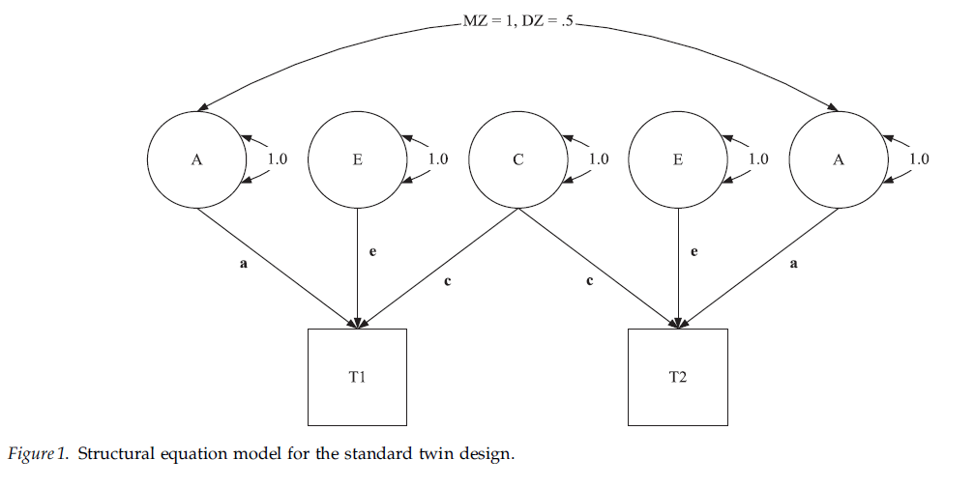
The Classical Univariate Model
(SEM representation, wide format)
Figure: Turkheimer et al. 2005: 1218
(one data row per twin pair/family)

Slide 11
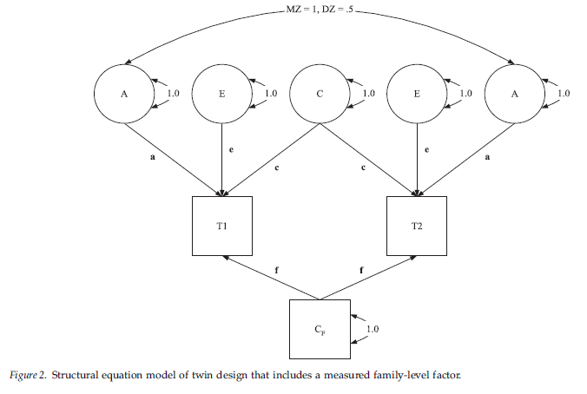
Twin Model with measured C
E.g. parents’ SES
Figure: Turkheimer et al. 2005: 1219

Slide 12
Assumptions of ACE decompositions
Genetic within twin-pair correlation of MZ twins is 1,
genetic within twin-pair correlation of DZ twins is .5
Genetic effects on phenotype are additive
= no epistasis, no interactions between effects of different genes
(otherwise assumed genetic correlation for DZ twins of .5 is wrong)
No gene-environment interactions or correlations (GxE or GEr)
(assumption can be relaxed by more complex GxE models or
non-parametric ACE decompositions, Guo and Wang 2002)
Phenotype can be approximated by a normal distribution

Slide 13
Assumptions of ACE decompositions (cont.)
Equal environment assumption (EAA)
= Same environmental influences for MZ and DZ twins
(if environments for MZ twins are more similar, A tends to be
inflated/overestimated, in case of IQ studies show that violation
of EEA does not inflate A , Derks et al. 2006)

Slide 14
Assumptions of ACE decompositions (cont.)
Equal environment assumption (EAA)
= Same environmental influences for MZ and DZ twins
(if environments for MZ twins are more similar, A tends to be
inflated/overestimated, in case of IQ studies show that violation
of EEA does not inflate A , Derks et al. 2006)
“Even if violations occur, these do not necessarily affect estimations, as long as differential treatment of MZ and DZ twins is unrelated or only weakly related to a trait under study; this is referred to as the ‘trait-relevant’ definition of EEA (LoParo & Waldman 2014: 611).” (Mönkediek 2021: 116)

Slide 15
Assumptions of ACE decompositions (cont.)
Equal environment assumption (EAA)
= Same environmental influences for MZ and DZ twins
(if environments for MZ twins are more similar, A tends to be
inflated/overestimated, in case of IQ studies show that violation
of EEA does not inflate A , Derks et al. 2006)
No assortative mating
= no positive correlation of parents regarding the phenotype
(possible correction using parents of twins-model or
correction formula of Loehlin et al., 2009: 0.5 + 0.5 * h₀² * r_{p}
with h₀² the heritability (share of A) given no assortative mating and
r_{p} the correlation of parents with respect to the phenotype)

Slide 16
Assumptions of ACE decompositions (cont. 2)
if all assumptions are met,
phenotype can be linear additively decomposed:
A + C + E with E including measurement error
This can be done using structural equation modeling
and “wide” formatted data
(one data row per twin pair/family),
But also using multilevel mixed-effects modeling
and “long” formatted data
(one data row per twin/person/person-year)

Slide 17
Implementation in R: Preparation
To load data-sets prepared in Stata into R:
install.packages("haven")
library(haven)
Using the twinflex-Package (by Mirko Ruks)
devtools::install_github('mirkoruks/twinflex')
library(twinflex)
https://github.com/mirkoruks/twinflex

Slide 18
Implementation in R: Preparation
Important packages:
install.packages("OpenMx")
library(OpenMx)
install.packages(" tidyverse")
library(tidyverse)
ALWAYS update your R version and all packages
(results may change when a version is updated)

Slide 19
Implementation in R: getting help
AFTER you loaded the library you can use
help(twinflex)
to get the help-screen with all information on
the twinflex-command!

Slide 20
Univariate ACE model: continious
Run model
univ_cont_tf <- twinflex(acevars = „VAR", data = dataset, sep = "_")
Show output
summary(univ_cont_tf)

Slide 21
Model with covariates: continious
Check model includes only valid cases
CovData <- data %>% filter(!is.na(sex) & !is.na(age))
Run model
univ_cont_tf_covars <- twinflex(acevars = " VAR", data = CovData, sep = "_", covvars = c("age","sex"), covariance = FALSE )
Show output
summary(univ_cont_tf_covars)
%>% - part of the „tidyverse“ – package (makes life easier!)

Slide 22
Univariate ACE model: continious
binary DV
univ_bin_tf <- twinflex(acevars = „VARbin", ordinal = "IQbin", data = data, sep = "_")
ordinal DV
univ_ord_tf <- twinflex(acevars = „VARord", ordinal = "IQord", data = data, sep = "_")

Slide 23
Drop parameters
Check which model fits the data best:
modelAE <- omxSetParameters(multi_GxE_chol_tf, labels= c(‘labelold‘, ‘labelold‘), free=FALSE, values=0)
modelfitAE <- mxRun(modelAE)
modelfitAE <- mxTryHard(modelAE)
Show output
summary(modelfitAE)

Slide 24
Example
Eichhorn, H. & Mönkediek, B. (under review). Do Sex Differences in Leisure Activities Result From Restrictive Environmental Influences? A Genetically Sensitive Analysis With Twin Data

Slide 25
Bivariate ACE models

Slide 26
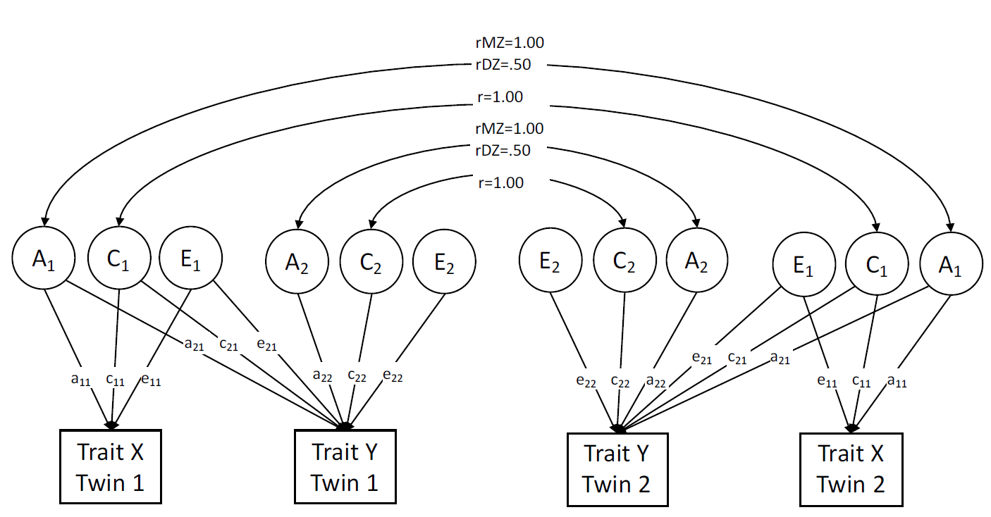
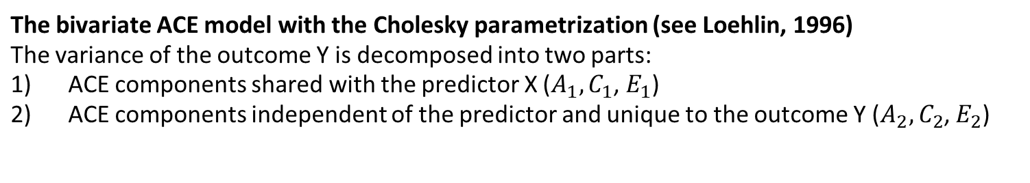
The bivariate twin model
The bivariate ACE model with the Cholesky parametrization (see Loehlin, 1996)
The variance of the outcome Y is decomposed into two parts:
ACE components shared with the predictor X ($A_{1},C_{1}$, $E_{1}$)
ACE components independent of the predictor and unique to the outcome Y ($A_{2},C_{2}$, $E_{2}$)

Slide 27
Introduction to the bivariate twin model
Why do we need bi-/multivariate ACE models?
We can decompose the variance (as in univariat ACE model) of each trait and we can also decompose the covariance of several traits (Plomin et al., 2013)
We can investigate causes of covariation between two traits (e.g., by estimates of bivariate heritability) and delineate genetic and environmental influences on human trait covariation
Besides causes of trait covariances, genetic and environmental trait correlations can be obtained that are additionally informative to answer research questions (de Vries et al., 2021)
Notes:
Distinct information about covariance and overlap between phenotypes are obtained from phenotypic correlations, estimates of bivariate heritability, and genetic and environmental correlations resulting from bivariate twin models (de Vries et al. 2021)

Slide 28
Introduction to the bivariate twin model
Why do we need bi-/multivariate ACE models?
Covariation between two (or more) traits is decomposed into genetic and environmental components in addition to trait specific variance decomoposition
  How much of the phenotypic correlation between traits is accounted for by genetic and environmental factors?
Bivariate heritability = proportion of covariance explained by genetic factors (de Vries et al. 2021)

Slide 29

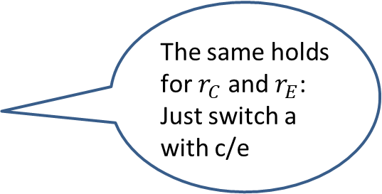


Trait Covariation and Trait Correlation
$$r_{A}$$
$$r_{A}$$
Example: Using path tracing rules or covariance algebra we can show that the genetic correlation is formally defined as:
r_{A} = Covariance due to shared genetic factors divided by the product of the genetic variances
The same holds for $r_{C}$ and $r_{E}$: Just switch a with c/e
Notes:
No contradiction with common non-shared environmental factors
Common with respect to the variables
Shared with respect to the two twins

Slide 30
Introduction to the bivariate twin model
Hence, we can adress the following questions with a multivariate twin model:
Why do traits covary?
  Trait Covariation/ Bivariate Heritability ( = genetic factors explaining trait covariation)
What factors account for/explain the heritability of Y?
  Trait correlation

Slide 31
Bivariate ACE model: continious
Run model
biv_cont_tf <- twinflex(acevars = c(“VAR“, “VAR“), data = dataset, sep = "_")
Show output
summary(biv_cont_tf)

Slide 32
Example: Parenting and math grades

Slide 33
Example: Parenting and math grades
No common A and no common E
Common C ?

Slide 34
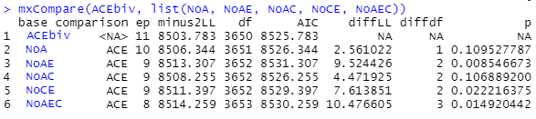
Example: Parenting and math grades
Compare nested models, stepwise exclude path:

Slide 35
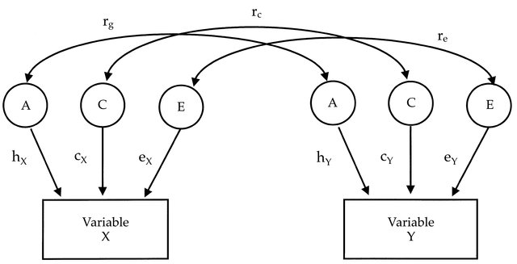
Variants of the bivariate model
Common variants of the bivariate model
There are different ways to conceptualize the structure of genetic (A), shared environmental (C) and non-shared environmental (E) factors
The here presented models can all be estimated using the “umx” package, for further details see Bates, Maes and Neale (2019)
See Roysamb and Tambs (2016) for more model types and explanations
The common factor model tests the hypothesis that effects (A, C and E) are mediated through one common phenotypic factor
Cholesky Model
…see previous slides of this presentation
Correlated factor model
Common factor model
Source:https://www.researchgate.net/publication/295999071_A_longitudinal_twin_study_of_specific_cognitive_abilities_in_preschool_children/figures?lo=1

Slide 36
References
Derks, E. M., Dolan, C. V., & Boomsma, D. I. (2006). A test of the equal environment assumption (EEA) in multivariate twin studies. Twin Research and Human Genetics, 9(3), 403-411. https://doi.org/10.1375/twin.9.3.403
de Vries, L. P., Van Beijsterveldt, T. C. E. M., Maes, H., Colodro-Conde, L., & Bartels, M. (2021). Genetic Influences on the Covariance and Genetic Correlations in a Bivariate Twin Model: An Application to Well-Being. Behavior Genetics, 51, 191–203. https://doi.org/10.1007/s10519-021-10046-y
Eichhorn, H. & Mönkediek, B. (under review). Do Sex Differences in Leisure Activities Result From Restrictive Environmental Influences? A Genetically Sensitive Analysis With Twin Data. Unpublished manuscript.
Freese, J., & Shostak, S. (2009). Genetics and Social Inquiry. Annual Review of Sociology, 35(1), 107–128. https://doi.org/10.1146/annurev-soc-070308-120040
Knopik, V. S., Neiderhiser, J. M., DeFries, J. C., & Plomin, R. (2017). Behavioral genetics (7th Edition). Worth Publishers.
Loehlin, J. C. (1996). The Cholesky approach: A cautionary note. Behavior Genetics, 26(1), 65–69. https://doi.org/10.1007/bf02361160
McGue, M., & Gottesman, I. I. (2015). Behavioral genetics. In The encyclopedia of clinical psychology (Vol. 1: A – Cli, pp. 341-351).

Slide 37
References
Mönkediek, B. (2021). Trait-specific testing of the equal environment assumption: the case of school grades and upper secondary school attendance. Journal of Family Research, 33(1), 115-147. https://doi.org/10.20377/jfr-381
Neale, M. C., & Cardon, L. R. (2013). Methodology for genetic studies of twins and families. Springer Science & Business Media.
Plomin, R., DeFries, J. C., Knopik, V. S., & Neiderhiser, J. M. (2013). Behavioral genetics (Sixth Edition). Worth Publishers.
Turkheimer, E., D'Onofrio, B. M., Maes, H. H., & Eaves, L. J. (2005). Analysis and interpretation of twin studies including measures of the shared environment. Child Development, 76(6), 1217-1233. https://doi.org/10.1111/j.1467-8624.2005.00845.x-i1
Visscher, P. M., Hill, W. G., & Wray, N. R. (2008). Heritability in the genomics era — concepts and misconceptions. Nature Reviews Genetics, 9(4), 255–266. https://doi.org/10.1038/nrg2322

